Slide 1
How to use PRINCE2® with agile ways of working Practitioner Course
© Copyright AXELOS Limited 2015. “PRINCE2 Agile™ is a trade mark of AXELOS Limited. All rights reserved.

Slide 2
Welcome

Slide 3
About yourself
Name (and company)
Role
Experience of PRINCE2
Experience of agile
Your objective for this course
Notes:
Trainer to show this slide, ask delegates to prepare to introduce themselves to the group using the headings shown.
The trainer should lead off, introduce themselves and their background first, to give delegates time to gather their thoughts.
It is very likely that there will be a wide variety of experiences amongst the delegates, therefore people should be put at ease if they have very little knowledge in certain areas.
Perhaps ask how many people have used a method called ‘winging it’ or the ‘Nike method’ i.e. just do it.

Slide 4
COURSE OBJECTIVES
Understand the basic concepts of common agile ways of working
Understand the purpose and context for combining PRINCE2 and agile ways of working
Be able to apply and evaluate the focus areas to a project in an agile context
Be able to fix and flex the six aspects of a project in an agile context
Apply the PRINCE2 principles and tailor the themes, processes and management products to a project in an agile context
To learn through the use of theory and practical exercises
To prepare delegates for the PRINCE2 Agile Practitioner exam

Slide 5
About the PRINCE2 AGILE manual
Aligned to the PRINCE2 2017 manual (to be released mid-2018)
Early chapters
Basic understandings and drivers for PRINCE2 Agile
Middle chapters
Discussion and description of the principles, themes, processes and products
What you may find
What to do
Final chapters
Focus areas: where PRINCE2 needs more detailed guidance when in an agile context
The appendices
Notes:
Based on the version of the PRINCE2 manual (2009) but updated to address name changes and minor updates
The current PRINCE2 Agile manual does not yet address the new sections in the 2017 version of PRINCE2 relating to minimum requirements
Points out that the PRINCE2 Agile manual is deliberately split into three sections. The reason for this is that section 1 is needed to create a baseline of understanding about what agile is and what PRINCE2 Agile is. Section 2 is the main body of the manual where PRINCE2 is tailored to operate in an agile environment, and section 3 contains specific areas of information that is needed to provide more detail where PRINCE2 only provides basic information which is not really enough when needing to work in an agile context.

Slide 6
PRACTITIONER exam structure
2.5 hour exam
Open book: PRINCE2 Agile manual only
Objective Testing Exam
Taken on the afternoon of the third day
50 questions each worth 1 mark
Pass is 60% or 30 marks
Notes:
Explain what OTE is.
Perhaps mention blooms taxonomy as the exam focuses predominantly on level 3 and level 4 questions. There are no level 1 questions.
Note: Timing of the exam may differ depending on the training provider.

Slide 7
Project or BAU
PRINCE2 and PRINCE2 Agile are only suitable for projects
Agile can be used on projects and for ongoing ‘Business as Usual’ (BAU) work
Important to understand the difference between projects and BAU to use agile appropriately
To a project context that is what PRINCE2 agile seeks to achieve
Notes:
Syllabus Area
Learning Outcome 1.
Assessment Criteria 1.2
It is critical from the outset to ensure that every delegate understands the difference between project work and BAU work.
Most of what is said and written about agile refers to BAU but PRINCE2 Agile does not operate in a BAU environment.
The point of PRINCE2 Agile is to run projects in an agile context and it is therefore the application of agile ways of working (that work well in a BAU context) in a project context. This is what PRINCE2 Agile seeks to achieve.

Slide 8
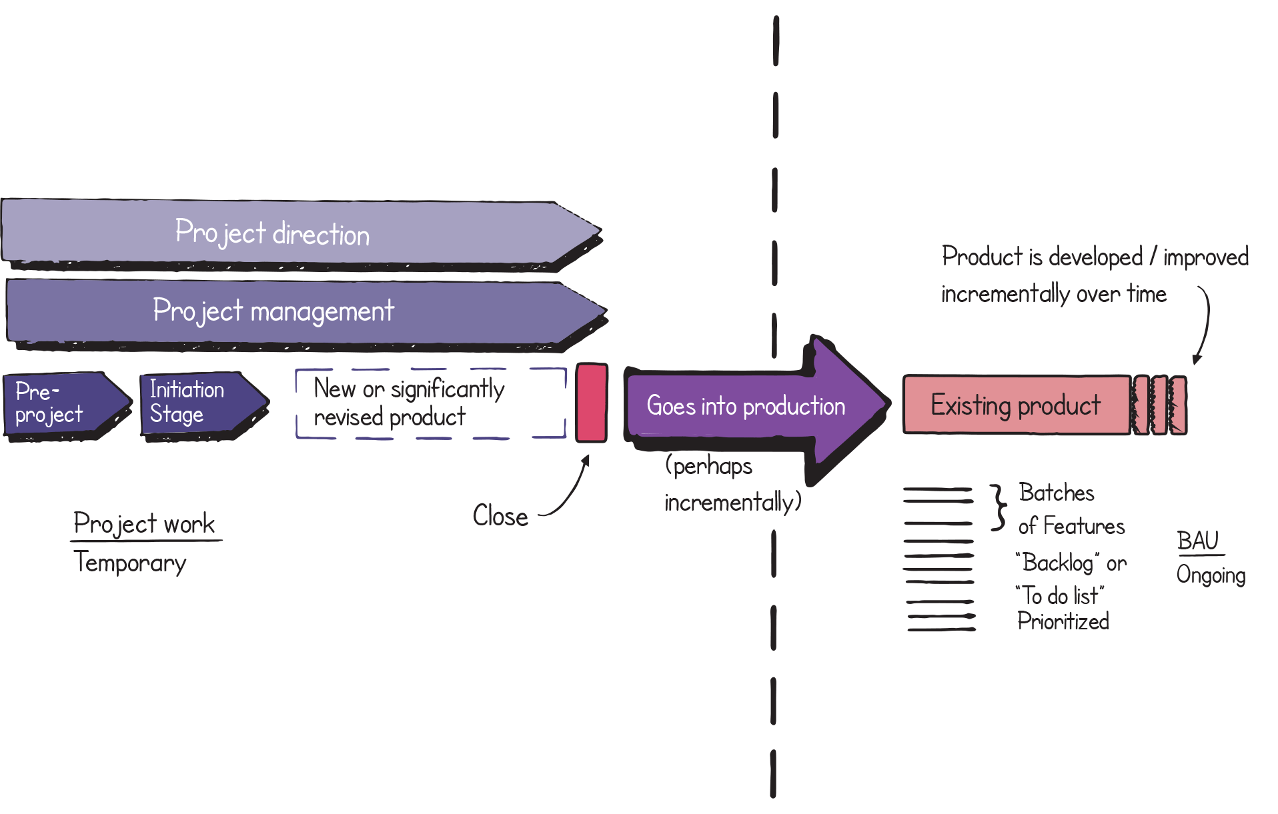
The difference between project work and BAU work
Guidance reference: Figure 1.1
Notes:
Syllabus Area
Learning Outcome 1.
Assessment Criteria 1.2
It is critical from the outset to ensure that every delegate understands the difference between project work and BAU work.
Most of what is said and written about agile refers to BAU but PRINCE2 Agile does not operate in a BAU environment.
The point of PRINCE2 Agile is to run projects in an agile context and it is therefore the application of agile ways of working (that work well in a BAU context) in a project context. This is what PRINCE2 Agile seeks to achieve.

Slide 9
An overview of agile
The term ‘agile’ is viewed in many different ways
Well-known frameworks referred to as ‘agile ways of working’
Well-known behaviours, concepts and techniques characterising agile
The Agile Manifesto comes closest to a single definition – it was created as an alternative to ‘waterfall’ processes
Agile addressed the new demands placed on the delivery of software
Guidance reference: Section 2.1
Notes:
Syllabus Area
Learning Outcome 1
Assessment Criteria 1.1
It is critical to position what agile is and what agile is not to all of the delegates. It can sometimes be a useful discussion topic to ask the delegates what they think agile is.
Chapter 2 in the manual does provide a summary of the many views of agile and categorises them in various forms. One such categorisation is whether agile is seen as a basic way of processing a to-do list or if it involves a much more holistic approach, such as one that also includes project work.
It is important to understand the role of the agile manifesto as this is what has caused agile to become so popular. However, by its own definition it would preclude many things that are now seen as agile, for example projects and non-IT work.
Chapter 2 should be fully understood as the trainer may receive challenges from people on what their (i.e. the delegate) view of agile is, for example some people feel it is quite simply an attitude or mind-set. Although this view is quite valid, it is A view it is not necessarily THE view that is universally accepted.
An important element for the trainer to understand and get across to the delegates is that PRINCE2 Agile sees agile as a collection of frameworks, behaviours, concepts and techniques therefore it is all embracing of any agile idea concepts or approach.

Slide 10
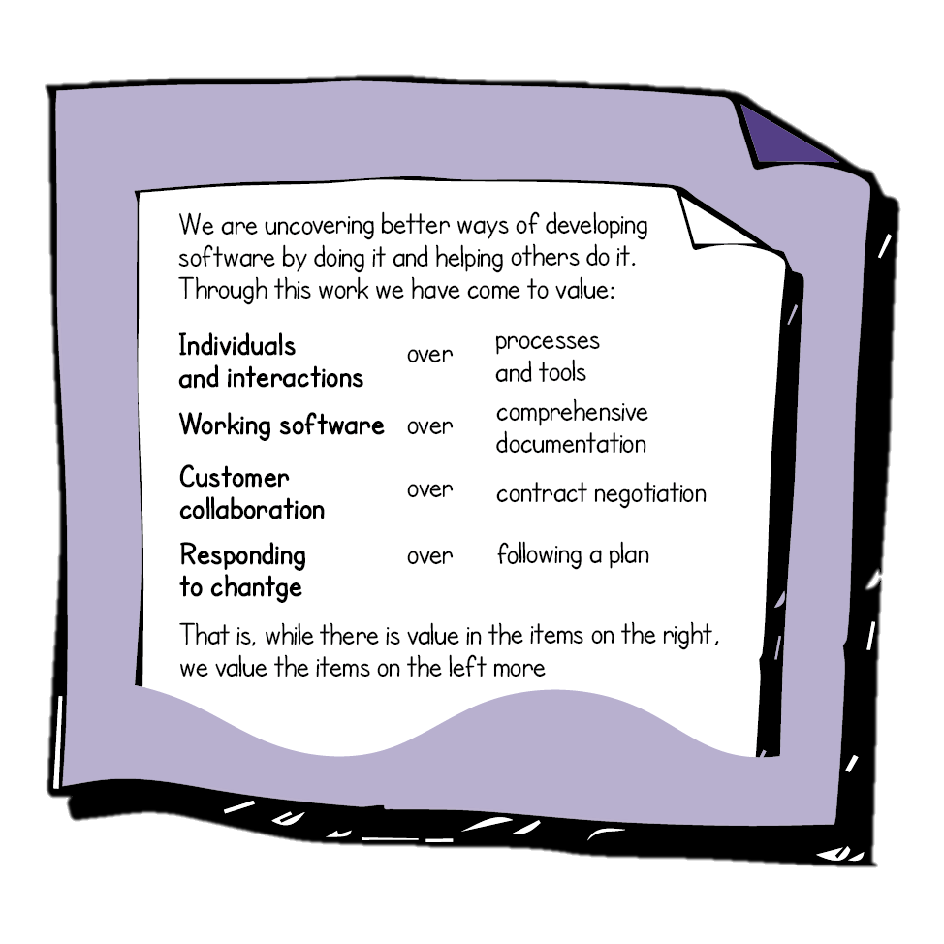
The Agile Manifesto
Guidance reference: Figure 2.1
Notes:
Syllabus Area
Learning Outcome 1.
Assessment Criteria 1.1
Ensure that the point at the bottom of the diagram is highlighted strongly and make it clear that there is no good /bad side, and it is more about what is valued the most. It is worth highlighting that although the word software is included, it is there as an example and could be replaced by product or solution.
If you want to make an ironic point you could say that the manifesto was reviewed 10 years after it was created (in 2001) and it was decided that nothing needed to be changed, which would seem at odds with the fourth value!

Slide 11
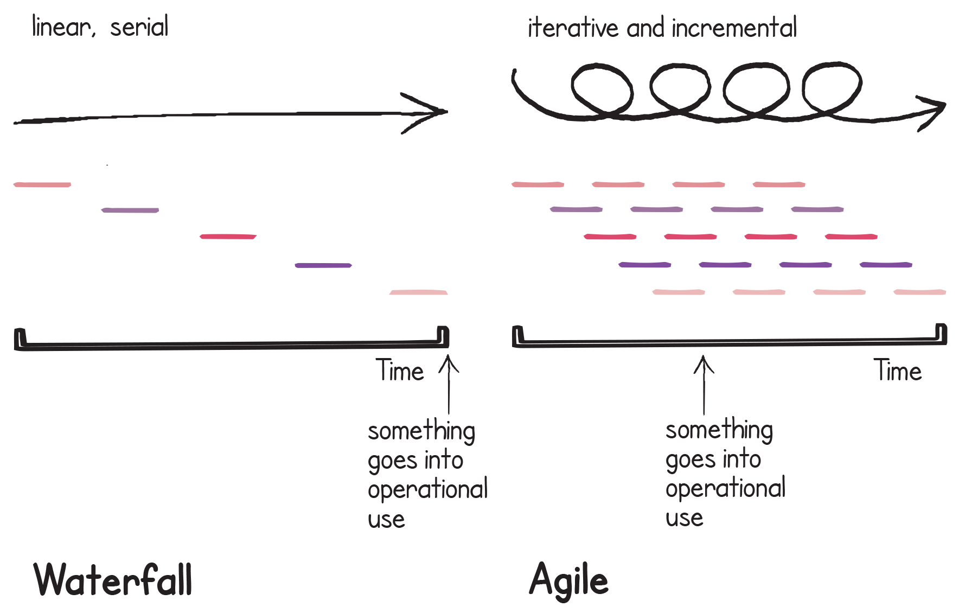
Waterfall or Iterative and Incremental
Guidance reference: Figure 2.2
Notes:
Syllabus Area
Learning Outcome 2.
Assessment Criteria 2.1
This can be demonstrated on the flip chart if preferred. It is worth pointing out that waterfall is not necessarily a bad approach and that agile could be described as a series of mini-waterfalls. A key point that could be made is that waterfall is a lot better than unstructured agile sometimes referred to as ‘fragile agile’.

Slide 12
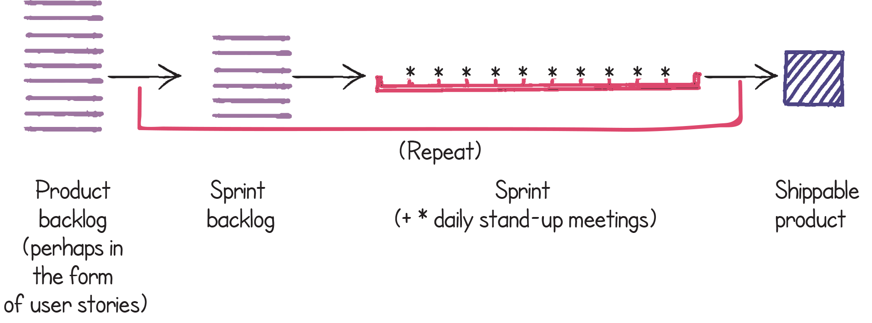
Agile basics
It can be viewed in many ways
Timeboxed approach for developing software
A collection of techniques
Using the Scrum framework.
A basic Backlog and Sprint structure is commonly used
Guidance reference: Figure 2.3
Notes:
Syllabus
Learning Outcome 1.
Assessment Criteria 1.1
A very common view of agile is that it looks like this. The view is very common although many people nowadays see a bigger view of agile. This view is similar to the scrum view.

Slide 13
Beyond a basic view
Vision, Roadmap and Releases
Non-IT situations
Project work
Flow-based working
A wider mind-set.
A more comprehensive view would include:
Guidance reference: Section 2.2
Notes:
Syllabus Area
Learning Outcome 1
Assessment Criteria 1.2
In simple terms, the PRINCE2 Agile manual refers to a basic view of agile (shown in the previous slide) and a mature view of agile. The trainer should appreciate that this mature view of agile can come in two forms: firstly it is an extension of the basic view of agile where concepts such as releases, roadmaps and visions are applied over the top of a basic view; or secondly it is a full-blown project framework operating in an agile context.
Again the trainer should be aware that delegates may have a mixture of experiences and a mixture of views. When training PRINCE2 Agile it should be remembered that allowing for all of these different views is important, because to restrict the definition of agile to only specific things will exclude certain areas of agile that are widely accepted and valid, e.g. using agile for non-IT situations, or using Kanban which does not mandate the use of timeboxes.

Slide 14
Agile Frameworks
Many frameworks are recognised as being agile
Some are more common than others
Some are only applicable to IT.
Scrum Kanban
Lean Lean Startup
XP SAFe DAD
DSDM/AgilePM
DevOps
FDD Crystal ASD
Guidance reference: Section 2.2.1, Table 2.1
Notes:
Syllabus Area
Learning Outcome 1.
Assessment Criteria 1.3
The frameworks identified in red are the ones detailed in the PRINCE2 Agile manual.
There was a conscious decision in the PRINCE2 Agile manual not to go into great detail on all of the agile methods that are available. This was to avoid inaccurate interpretations. It should be pointed out that many of these are IT methods.
As a trainer you should be familiar with what is written in table 2.1 further research on all of these areas would be advantageous. Two main areas to become as familiar as possible with are Scrum and Kanban.

Slide 15
Agile behaviours, concepts and techniques
Along with the agile frameworks there are a variety of behaviours, concepts and techniques that are seen as being part of the agile way of working
A few illustrative examples
Guidance reference: Section 2.2.2, Table 2.2
Notes:
Syllabus Area
Learning Outcome 1.
Assessment Criteria 1.3
It is important to point out that these are illustrations and not a definitive list. Further to this, it is possible that one word may fit into more than one of the categories in the left-hand column. It can sometimes be useful to explain to the delegates that techniques are in effect standalone and many of the techniques used in agile can be used quite happily in a waterfall context.

Slide 16
The PRINCE2 Agile view
PRINCE2 Agile
Regards agile as a ‘family of behaviours,
concepts, frameworks and Techniques.
Guidance reference: Section 2.2.1
Notes:
Syllabus Area
Learning Outcome 1.
Assessment Criteria 1.3
This slide should then pull everything together from the viewpoint of what agile is and how PRINCE2 Agile sees it.

Slide 17
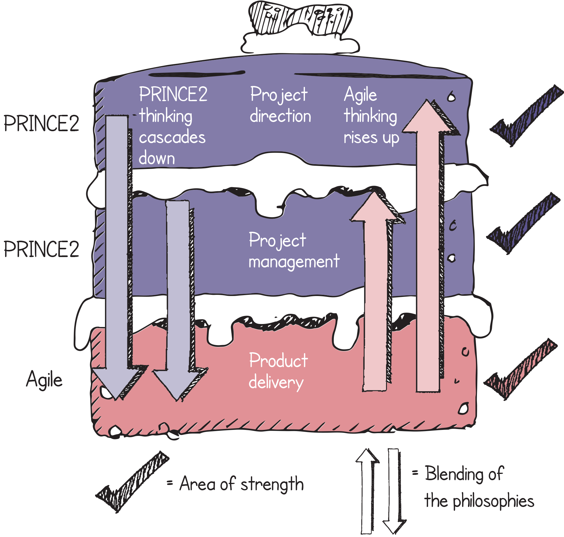
PRINCE2 Agile blending PRINCE2 and agile together
They each have their own strengths
Who is it for?
When and where should it be used?
Guidance reference: Section 3.1, Figure 3.1
Notes:
Syllabus Area
Learning Outcome 2
Assessment Criteria 2.3
This is known as the cake or sometimes the layer cake.
It represents the three levels of a project and the important point of the metaphor is that both PRINCE2 and agile have their strengths and we need to play to those strengths. But, we must blend and weave these together as it will not work as well if they are running in parallel universes.
It would be good to give examples of how agile can work higher up the cake, and alternatively, how structure can work further down the cake, e.g. is the project board happy to prioritise their objectives and perhaps go without certain features; are the delivery teams happy to work within some degree of formality that may be provided by such a mechanism as the work package; in fact are the delivery teams happy that a project manager even exists as this will be an issue for many in the agile community.
The message is to deliver very firmly are about blending and weaving all the ingredients together to create something greater than the sum of the parts.

Slide 18
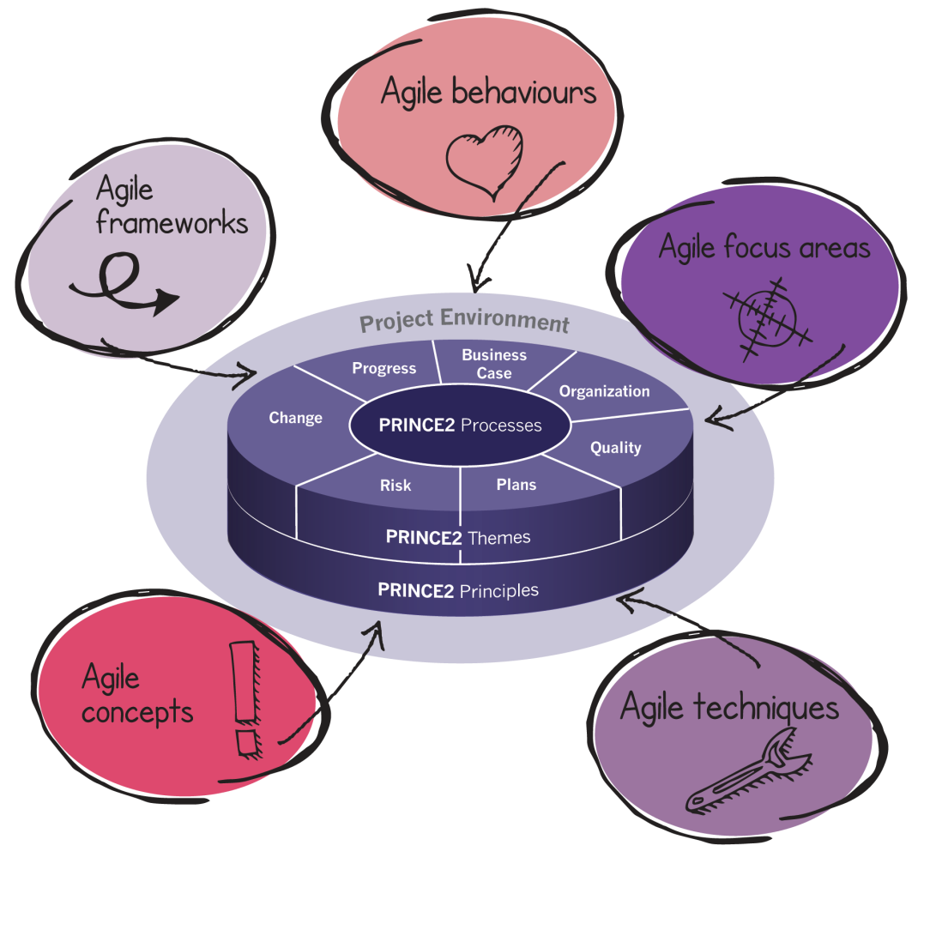
What does PRINCE2 Agile comprise of?
Guidance reference: Section 3.6, Figure 3.2
Notes:
Syllabus Area
Learning Outcome 1
Assessment Criteria 1.3
So what is in PRINCE2 Agile? It is essentially PRINCE2 with tailoring guidance and a few extra bits added on. Nothing is removed from PRINCE2.
The diagram complements the earlier point about PRINCE2 Agile seeing agile as a family of frameworks, concepts, behaviours and techniques along with five focus areas that are in the third section of the manual also included on this diagram.

Slide 19
8 Guidance Points
Guidance reference: Section 3.7
Notes:
Syllabus Area
Learning Outcome 2
Assessment Criteria 2.2
An important point when training PRINCE2 Agile is that during the morning of day one (when trying to establish baselines for areas such as what is agile?), it is vital that this table of eight points is understood by all of the delegates. They may not agree with some of the points but the fact is, they are all points upon which PRINCE2 Agile is based. Possibly the most important of all of these eight points is the first one because most people will not realise this.
This (i.e. point 1) could not be said of the previous version of PRINCE2. The second point is also a critical point that all delegates need to understand. PRINCE2 is usually classified (stereotyped?) as ‘a traditional waterfall project management approach’ but that statement (which could be applied to the pre-2009 versions of PRINCE2) cannot be attributed to the current version. The fact that this impression (or prejudice) may still exist needs to be addressed head-on when training PRINCE2 Agile.
All of these points are significant, such as highlighting that agile is more than just scrum, which is a view that will be held by many people. They may even refer to their own method as agile scrum!
Take care with point 8 because although it is true, it is very easy to refer to an ‘agile project’ when talking. If an ‘agile project’ exists then by definition a ‘non-agile project’ exists as well and PRINCE2 Agile is written with a view that agile is a question of how much and not a question of yes or no.
Before leaving this slide it may be a good idea to check that everyone is on board as the 20 slides so far are very much about baselining people’s understanding of the context that PRINCE2 Agile is operating within. The rest of the course is then built on top of this.

Slide 20
Beware of prejudice!
Control and governance allows agile to be used in complex environments.
Guidance reference: Section 3.8
Notes:
Syllabus Area
Learning Outcome 2
Assessment Criteria 2.1
The Eurofighter Typhoon is a good analogy to use at this point. It is an aeroplane that is inherently unstable through design.
Therefore it can be very agile in a combat situation. The way the analogy works is to highlight that agility does not come and sacrifice governance and control. In fact quite, it is the opposite. There is more governance and control on the Eurofighter than there is on a jumbo jet for example.

Slide 21
The prince2 journey with agile
How PRINCE2 may look in an agile context
Please note the word ‘typically’
…and ‘a way’ not ‘the way’
Tailoring PRINCE2 depends on the project context and may affect:
the level of formality
where the emphasis is placed
how it is carried out.
Guidance reference: Section 4.1, Figure 4.1
Notes:
Syllabus Area
Learning Outcome 2
Assessment Criteria 2.3
It may be worth mentioning why this is being referenced at this point. It is because there is something in the PRINCE2 manual called ‘the PRINCE2 journey’ and as part of the baselining of PRINCE2 Agile (in section 1 of the manual) this has been included to show how it would look in an agile context. What this enables the trainer to do at this point, is to give a very quick overview (or helicopter view) of PRINCE2 Agile with a view to explaining to delegates that the detail of this will be carried out during the rest of the course.
Stress that the PRINCE2 journey with agile is a way not the way and it would be appropriate at this point to explain that a lot of information and guidance throughout the manual is in a similar style: namely it is giving you guidance on how you could approach certain situations. Because agile comes in many forms and varieties, it is often difficult to give specific advice and to say that for example ‘estimation must be done in a certain way’. So using this journey slide gives an opportunity for the trainer to bring in this concept of a way and not necessarily the way. There are ‘many ways to skin a cat’ (or other similar appropriate example) you may prefer to describe this more appropriately.

Slide 22
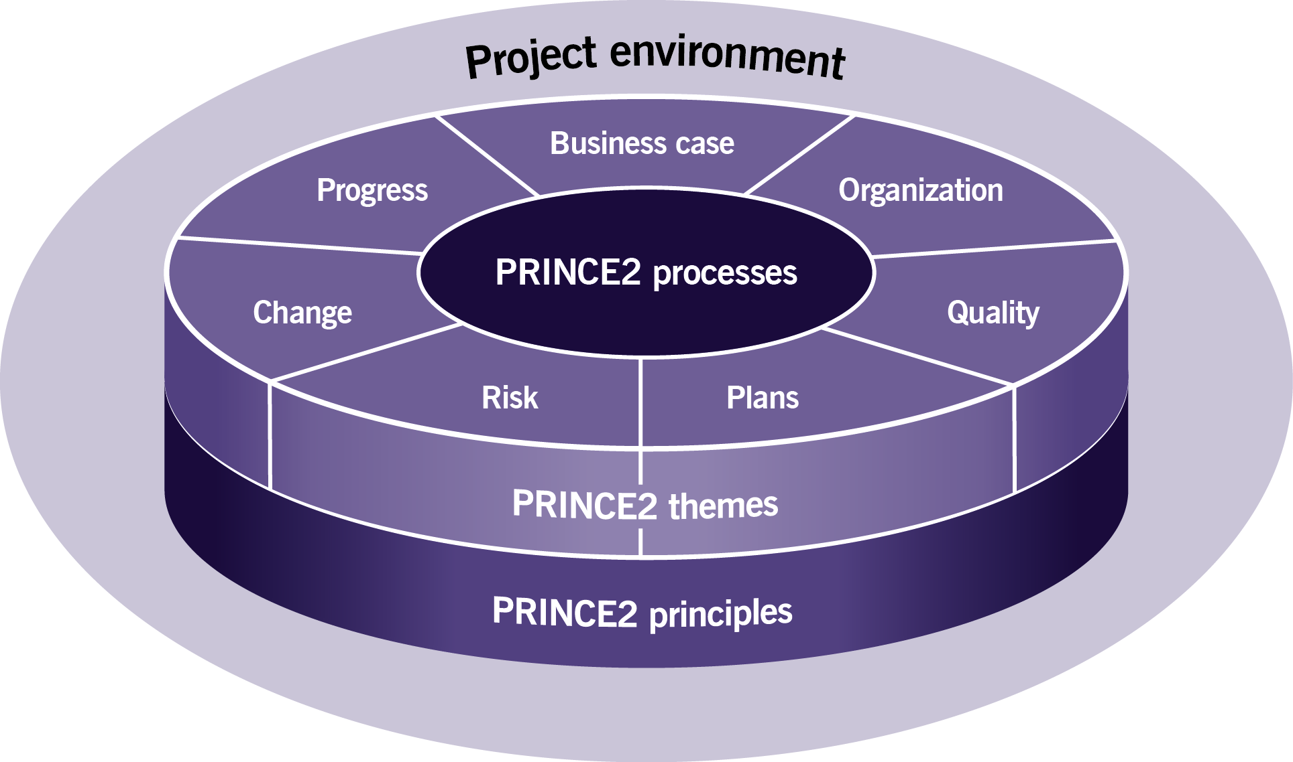
PRINCE2
Guidance reference: Chapter 5, Figure 5.2
Notes:
Syllabus Area
Learning Outcome 2
Assessment Criteria 2.4
Fundamental to delegates attending this course is that they are PRINCE2 practitioners and as described in the pre-course reading they should be up to date. Therefore this session should be short for example 10 minutes and if this session was to last much longer it may annoy delegates who have come appropriately prepared.
To make this session a little more fun it could be turned into a quiz where people working in pairs are asked to remember the seven themes, the seven processes and the seven principles. Management products might be a lot harder although you could turn this into a game of ‘killer’ whereby the first one to get one wrong makes the coffees.

Slide 23
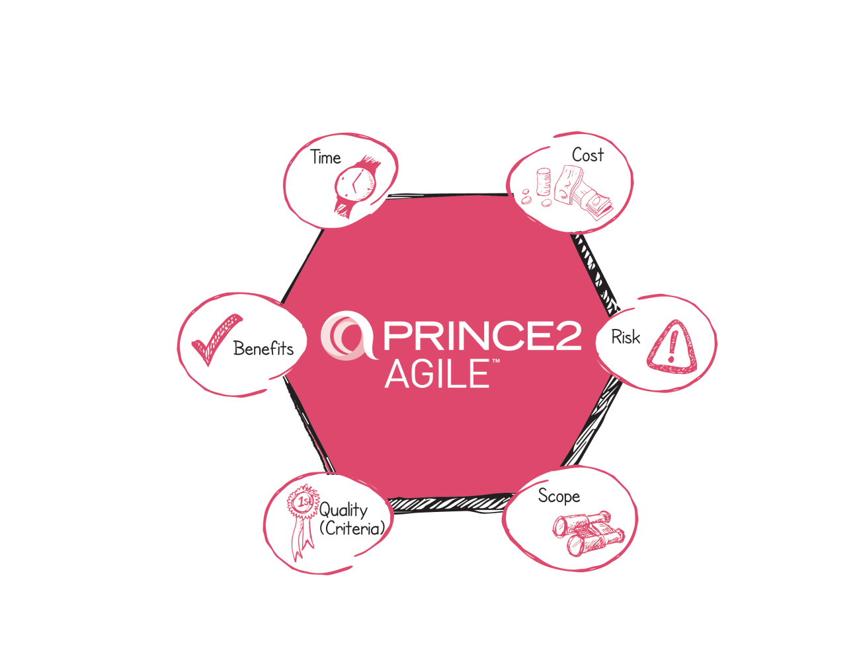
The Hexagon
PRINCE2 considers 6 common performance targets
Tolerance is an allowable variation around these targets without the need to raise an exception
Guidance reference: Section 6.1
Notes:
Syllabus Area
Learning Outcome 4
Assessment Criteria 4.1
Possibly the most important part of the three days is to go through PRINCE2 Agile hexagon and explain what it is. It may be a good starting point to talk about many decades of project management training that have focused on the use of some form of triangle in order to talk about the competing constraints on a project. These triangles actually come in many forms. They are not just TQC and depending on how the trainer wishes to train in this session, it could be said that PRINCE2 Agile has moved on from the triangles; i.e. there are no more triangles and what we have now is a hexagon. This may provoke laughs or groans but the most important part of the slides relating to the hexagon is to ensure the delegates understand what this is trying to say.
It may be worth explaining that the previous version of PRINCE2 put a lot of emphasis on managing time and cost whereas the 2009 version of PRINCE2 sees the six aspects as equals. It may be appropriate to stress that this change in emphasis represents a very significant change to PRINCE2 and in so doing, automatically enabled PRINCE2 to be tailored to suit agile.
In simple terms, the previous version of PRINCE2 varies time and cost whereas agile does not; therefore they could have been said in the past to be incompatible. However since 2009 where all six aspects are now seen as being equal this allows easy tailoring of PRINCE2 to embrace agile by applying the six aspects and very importantly their tolerances in an agile friendly way.

Slide 24
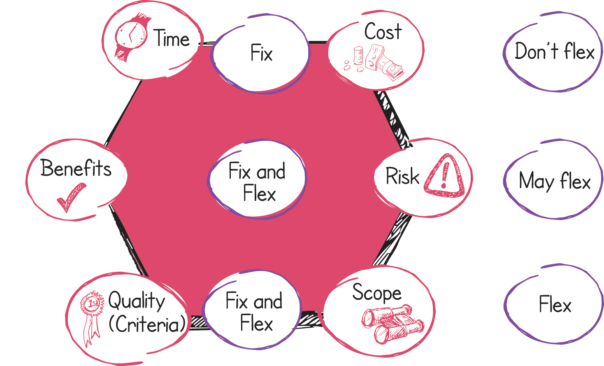
The Hexagon
Guidance reference: Section 6.1, Figure 6.1
Notes:
Syllabus Area
Learning Outcome 4
Assessment Criteria 4.1
An easy way to convey how to use the tolerances with respect to the six aspects is to use the expression Fix and Flex. It is possible that this session (which may last 20 minutes or longer) is the most important of the three days because it is the cornerstone of how PRINCE2 Agile works. Importantly the trainer should be aware that some delegates may not see this as how ‘agile’ works from their own viewpoint and although this viewpoint is quite legitimate and acceptable, it is not how ‘PRINCE2 Agile’ works. This distinction may be important.
When training the Hexagon it may be best to summarise briefly how the six aspects are fixed or flexed, and then explain the detailed rationale for this in the subsequent slides which refer to the targets which represent why the hexagon is like it is. An important point to get across to delegates is that they need to understand why the hexagon is like it is and not just do what the hexagon says.

Slide 25
What to fix and what to flex
This is about tolerances and not the aspects themselves
Guidance reference: Section 6.1, Figure 6.1
Notes:
Syllabus Area
Learning Outcome 4
Assessment Criteria 4.1
This slide can then be used by the trainer to accentuate the point that it is about the tolerances and not the aspects themselves. What this means is that if you do wish to extend a stage or a project that has zero time tolerance, it will go into exception.
Refer the delegates to table 6.1 and use this to summarise.
There is one unusual characteristic of the six tolerances and that is the risk aspect as it isn’t really perhaps relevant from a purely agile perspective. You can fix it or flex it as you see fit. You should not flex time and cost; you may flex benefits and you would certainly want to flex scope and quality criteria.
Risk is a bit funny in this respect!

Slide 26
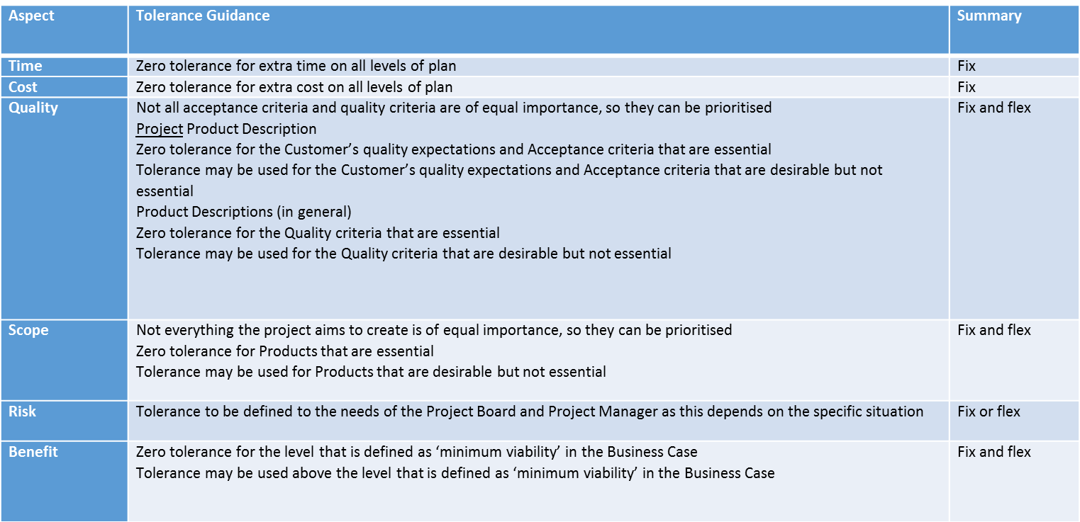
Tolerance guidance
Guidance reference: Section 6.1, Figure 6.1
Notes:
Syllabus Area
Learning Outcome 4
Assessment Criteria 4.1
Supports discussion on tolerances. It may be better to omit the slide and instead, reference the table in the manual.

Slide 27
The 5 targets
It is essential to understand why?
The 5 targets represent the rationale behind the hexagon
Be on time and hit deadlines
Protect the level of quality
Embrace change
Keep teams stable
Accept that the customer doesn’t need everything
Guidance reference: Section 6.4, Table 6.2
Notes:
Syllabus Area
Learning Outcome 4
Assessment Criteria 4.2
The word ‘target’ may seem an odd choice of word but it has been chosen because this is what you are trying to achieve. All five targets are either highly desirable or sensible concepts. If the delegates can understand the rationale behind every target, they then understand why the PRINCE2 Agile hexagon is like it is.
This detailed rationale is so important for the delegates to understand and it is detailed in each of the five following slides.
The five targets can be trained in various ways but one option is to use a flipchart and draw out from the delegates the advantages of the five targets. If the training is done this way the sequence should be to ask the delegates about the advantages of being on time. Then describing why teams should be kept stable. Then draw out the advantages from the delegates of responding to change. Back this point by describing why the customer doesn’t need everything…. And then finally the missing piece in the jigsaw is to explain that working this way can ultimately protect quality. When drawing out from the delegates views on protecting quality, it is worth asking the question ‘what do people do that compromises quality?’ The usual responses are statements like reduced testing, reduce the documentation, etc.

Slide 28
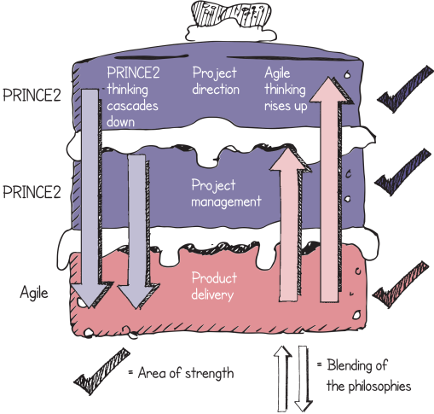
Be on time and hit deadlines
Why?
Early realisation of benefits
Helps with planning
Gives confidence
There may be no choice
Reduce the likelihood of cost overruns
Improves reputation
Guidance reference: Section 6.4.1
Notes:
It is vital for the trainer to get across that this point is massive. The reasons outlined on the slide are not minor benefits, they are hugely significant in a project context.
Time is one of the most powerful weapons in agile.

Slide 29
Embrace change
Why?
It is inevitable
A more accurate final product is more likely
Can be handled by flexing what is delivered
Guidance reference: Section 6.4.3
Notes:
Perhaps ask the delegates if this is likely to happen and why does it happen. Remember there are two types of change: big changes to the overall scope or refinement of the detail...
Setting a tolerance on scope and quality allows us to define the line between these two types of change.

Slide 30
Protect the level of Quality
Why?
To ensure that the appropriate level of quality is achieved
And therefore the desired outcomes are possible
Damaging effects result from:
Reduced testing
Incomplete documentation
Sub-optimal design
Lack of appropriate training
Non-compliance to standards
Guidance reference: Section 6.4.2
Notes:
P2 talks about fit for purpose... A level of quality that enables the desired outcomes to be achieved.
The consequence of poor quality is an increased TCO (total cost of ownership). Poor design, and its impact, is an area that can be worth facilitating a discussion about with the delegates.
Key to this is the way that we ultimately protect quality... We do less (we reduce function and feature) but maintain quality standards.

Slide 31
Keep teams stable
Why?
Agile favours self organising teams and informal communication
Changing team members (in the short term) can have a detrimental effect:
Time spent bringing new team members up to speed
Number of communication lines in the team
grows exponentially
An opportunity cost incurred to the areas providing the
new people
The team dynamics change and need to be re-established
Guidance reference: Section 6.4.4
Notes:
Most people will mention the impact of the learning curve on changing team members during a timebox but most people do not realise that it is the effect on team dynamics that can, but not always, be the most damaging.
It is worth pointing out that over longer term periods then team personnel may change. This target refers to short-term timescales and the point that adding people to a Timebox or Sprint is not a clever option with respect to agile.

Slide 32
Accept that the customer doesn’t need everything
Why?
If compromise is necessary PRINCE2 Agile believes that the safest way to do this is by varying the features of a product
This is because:
Usually, not everything defined at the start must be delivered
Many functions and features are rarely, or never used
This helps when trying to hit deadlines and protect the
level of quality
Delivers what the customer really wants more quickly
Guidance reference: Section 6.4.5
Notes:
We never set out to do less than planned and requested. But when we fall behind and things prove more difficult than we hoped, then we need to deal with challenges that this sets for us. If we are to meet deadlines and protect the level of quality, the safest way to do this is to reduce the amount of work that we do... To build less.
There are many examples of where many features are not used such as with an iPhone, or use the example in the manual of a washing machine: most people use two programs or less.

Slide 33
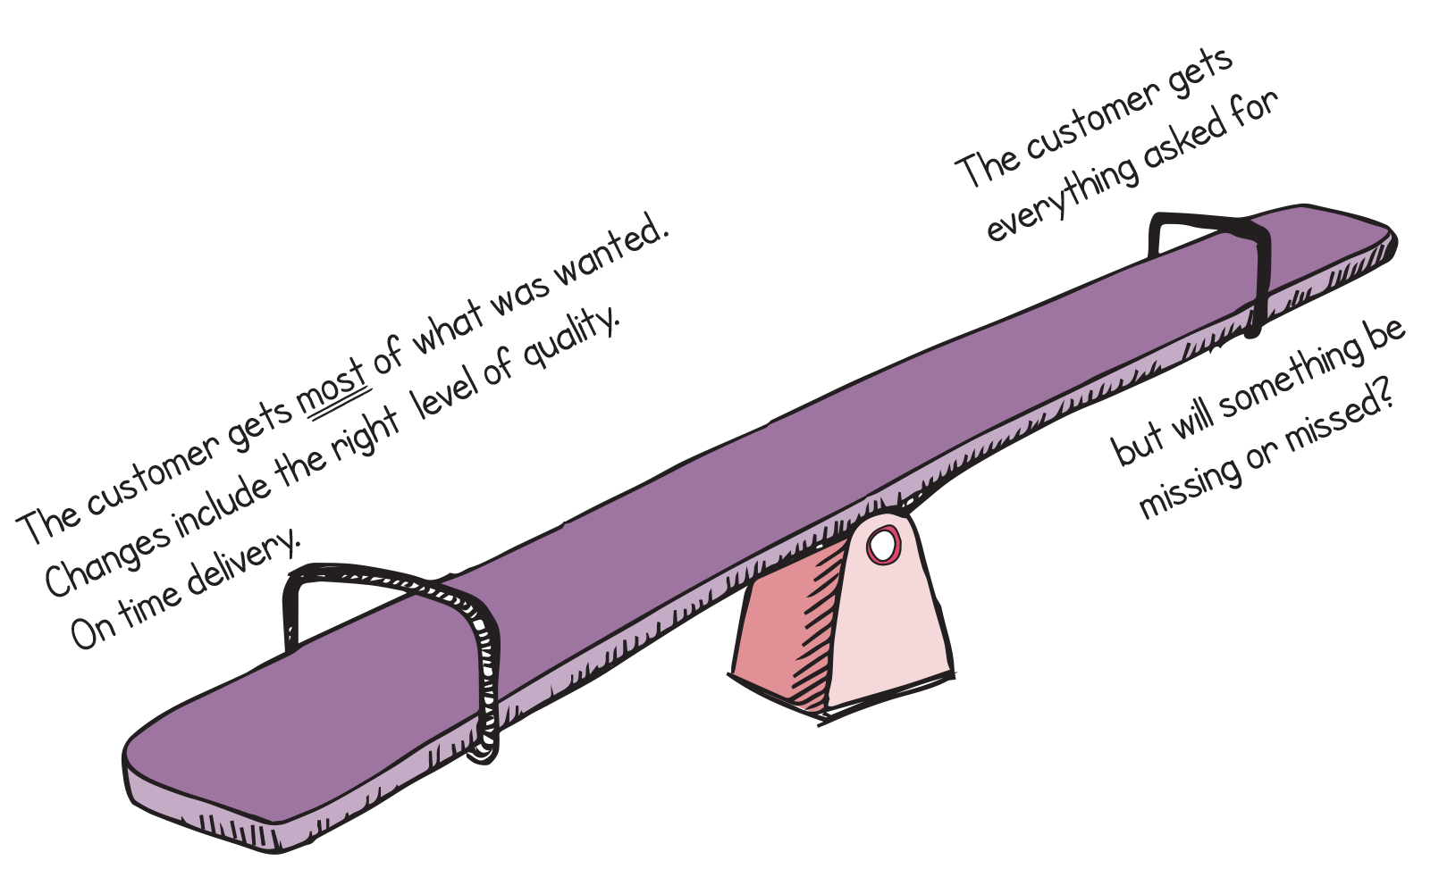
The appropriate balance
Is the holistic view understood?
Guidance reference: Section 6.4.5, Figure 6.2
Notes:
Syllabus Area
Learning Outcome 4
Assessment Criteria 4.2
When concluding the training of the hexagon and the five targets, it is worth checking the delegates have understood the wider holistic view. In essence, the PRINCE2 Agile view is that to be on time, to protect quality and to embrace change is a much better proposition for the customer than to deliver everything they asked for at the start of the project.
It can be a useful discussion if the delegates are asked who they feel benefits most from the hexagon. It usually generates a lot of debate and one school of thought is to suggest that the supplier can work in any way, e.g. waterfall or agile, and be happy with the outcome, whereas the deal shown by the seesaw benefits the customer.
It may be worth drawing out the irony that the customer doesn’t always get this point and prefers detailed requirements and detailed costings under the potential illusion that this is helping them secure a better outcome, when in a complicated project environment the opposite effect is perhaps more likely.

Slide 34
AGILE AND THE PRINCE2 PROCESSES
Notes:
Syllabus Area
Learning Outcome 5
Assessment Criteria 5.7

Slide 35
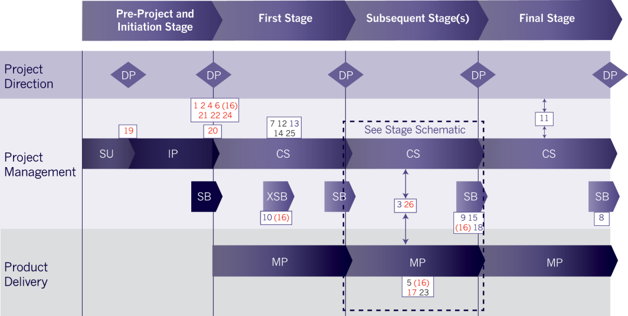
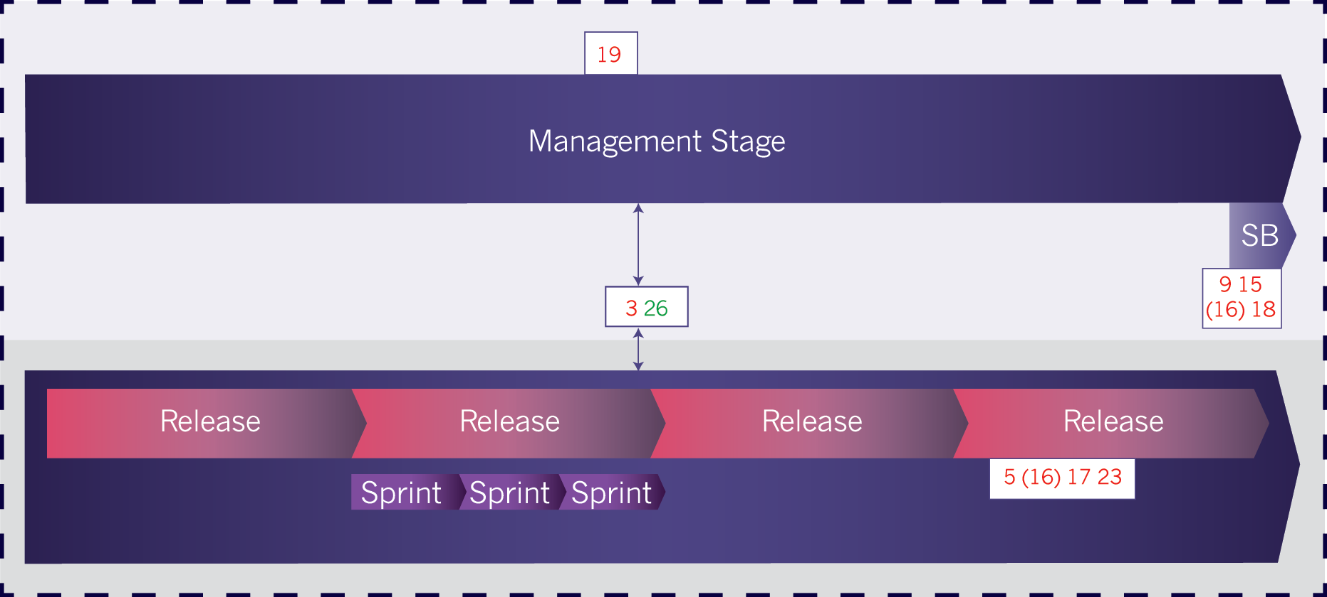
Agile and the PRINCE2 Processes
Agile needs to be incorporated into all 7 processes
The amount of agile that is appropriate to each process does vary
Guidance reference: Section 16.2, Figure 16.2, Figure 16.3
Notes:
Syllabus Area
Learning Outcome 5
Assessment Criteria 5.7
These diagrams show where agile fits into the PRINCE2 process model. The overall PRINCE2 process model doesn’t really change at the higher level because the action from a process point of view with respect to agile takes place at the product delivery level.
Again the diagram shows a way that a stage may be broken down. It should be pointed out that there are a variety of agile approaches and maybe only one release takes place per stage or potentially hundreds! What is being shown is a typical configuration. Also remember that sprints may not be being used it could be more flow-based as per Kanban.

Slide 36
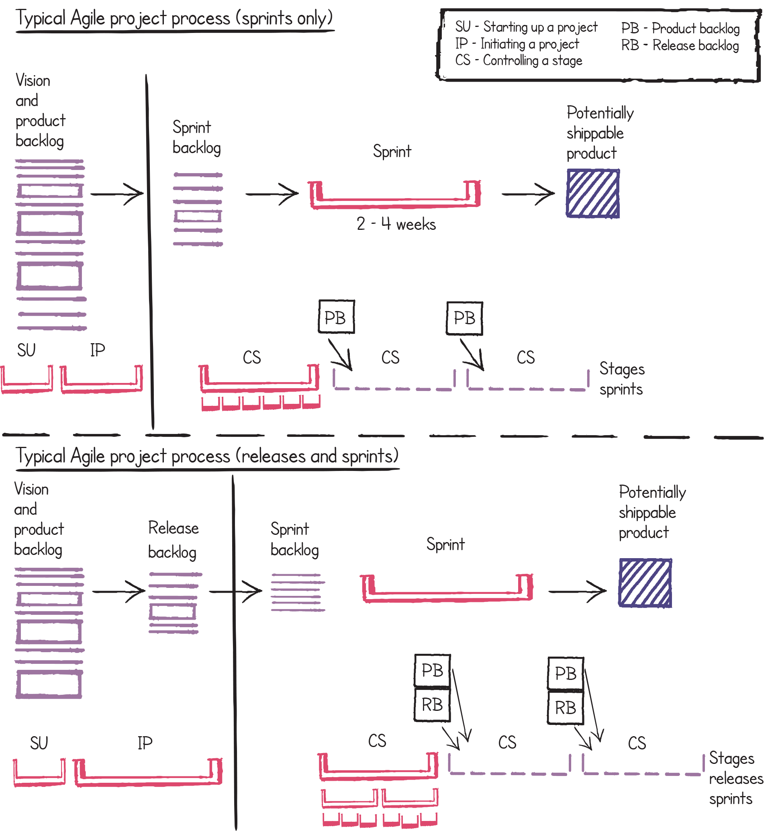
Relating agile processes to PRINCE2 processes
Guidance reference: Section 16.2, Figure 16.4
Notes:
Syllabus Area
Learning Outcome 5
Assessment Criteria 5.7
This diagram then relates how the typical agile process fits in to PRINCE2.
Please note this is how it fits into PRINCE2 and not PRINCE2 Agile .
Understanding this distinction is important because PRINCE2 Agile is not a new method or new framework, it is guidance on how to tailor PRINCE2 to work in an agile context.
Both of these diagrams are more mature than the basic backlog and Sprint view of agile. The bottom diagram could be said to be more mature than the top diagram as it supports the concept of releases which are typically larger container time boxes.
You could ask the delegates which of these two they see more often, but when you hear words like vision and product roadmap in an agile context, this is more advanced than a simple backlog and Sprint situation. It is important to point out that in the scrum guide the idea of vision and release backlogs do not exist.

Slide 37
Relating agile processes to PRINCE2 processes
Guidance reference: Section 16.2, Figure 16.4
Notes:
Syllabus Area
Learning Outcome 5
Assessment Criteria 5.7
This diagram then relates how the typical agile process fits in to PRINCE2.
Please note this is how it fits into PRINCE2 and not PRINCE2 Agile .
Understanding this distinction is important because PRINCE2 Agile is not a new method or new framework, it is guidance on how to tailor PRINCE2 to work in an agile context.
Both of these diagrams are more mature than the basic backlog and Sprint view of agile. The bottom diagram could be said to be more mature than the top diagram as it supports the concept of releases which are typically larger container time boxes.
You could ask the delegates which of these two they see more often, but when you hear words like vision and product roadmap in an agile context, this is more advanced than a simple backlog and Sprint situation. It is important to point out that in the scrum guide the idea of vision and release backlogs do not exist.

Slide 38
Starting up a Project and Initiating a Project
Up-front work – how much is done?
emergence
what constitutes ‘enough’
Visioning and chartering
Sprint zero, discovery
Starting with a backlog
What you may find
Guidance reference: Section 25.5.2, Table 25.3
Notes:
Syllabus Area
Learning Outcome 5
Assessment Criteria 5.7
At this stage the trainer should make a general point on how the training course is now going into more detail on each of the processes, principles and themes; therefore it is a good idea to explain to the delegates that we will be jumping around the chapters in the manual because the course is going to follow the typical route of a project as opposed to going through all of the chapters in the manual in sequence.
It is also important to make the general points that when explaining how to tailor processes, the style of the training course is to break this down into three sections which are about what you may find in an agile context, what you should do in an agile context and what this might look like in an agile context. All seven processes will be described this way. A key point to training PRINCE2 Agile is that when using PRINCE2 Agile you need to apply it to the situation that you are encountering as this may come in a variety of forms.
These two processes are joined together because it is very unusual to find a simple mapping of pre-delivery work in agile and map it easily to PRINCE2. As a general guidance point to any trainer running this course, it is often a good idea to ask delegates what they see or what they do in an agile context. For example asking delegates how they see projects initiated in an agile context will help inform the trainer as to what is going on in the real world. For example, one delegate will call it Sprint zero whereas another delegate will call it discovery. You may well find that some delegates just say “I have no idea, we just get on and build it”.
It is very important to inform delegates that the processes of SU and IP are still treated as distinct processes and are only combined in this chapter. They are not necessarily combined when in a project context (this may happen if the project is a small one).
Agile often uses the term emergence. You could discuss with the delegates what they feel about emergence such as letting the architecture for a solution emerge.
A good point to make at this stage is that a lot of agile thinking starts with a backlog, but where did the backlog come from. If it is a BAU situation then that’s okay. But what if you are in a project context?

Slide 39
Starting up a Project and Initiating a Project
Assess the level of uncertainty
Cynefin
Assess the agile environment
Agilometer
Define things at the right level
Outputs, Outcomes and Benefits
Project product description
High level requirements
Define things in the right way
To enable agile to work easier, e.g. outcome focussed
Set the project up in an appropriate manner
Integrating with agile teams, e.g. role names
Impact of frequent releases of products to enable and provide benefits
What to do
Guidance reference: Section 17.3
Notes:
Syllabus Area
Learning Outcome 5
Assessment Criteria 5.6
Cynefin will be discussed very shortly.
Not too much detail is required early on.
Agile is more focused on outcomes and benefits rather than the solution. This way of thinking allows for agility.
Refer to the agilometer and how much of agile can be used on the project, e.g. the frequency of releases.

Slide 40
Starting up a Project and Initiating a Project
The use of workshops
More informal control and communication
How it might look
Guidance reference: Section 17.3.2, Table 17.2
Notes:
Syllabus Area
Learning Outcome 5
Assessment Criteria 5.6
Exploring how to define the project

Slide 41
Cynefin
A decision-making framework to help determine the level of complexity
It describes the relationship between ‘cause and effect’
It determines how complex an environment is
It is used to help apply PRINCE2 and PRINCE2 Agile appropriately
Guidance reference: Section 17.4.1
Notes:
Syllabus Area
Learning Outcome 5
Assessment Criteria 5.6
It is quite likely that the Cynefin (Kuh-nev-in …rhymes with Kevin) framework is new to most people on the course and also the trainer. Therefore knowledge of this needs to be sought. The creator of this concept is called Dave Snowden, who has helped with PRINCE2 Agile. Watching some of Dave’s free videos would be strongly advised.
When training this it is important is to refer to it as a possible tool that could be used to make decisions. Its use is not mandated by PRINCE2 Agile. Its role in the manual is to stimulate debate and to raise the concept that we may approach different problems differently. So something highly innovative may need to be approached differently to something that is a reasonably straightforward project. The reason for the inclusion of this framework is that many areas of agile operate in very volatile and disruptive situations and much of what is talked about in agile assumes that this is the only situation that agile can be used in, whereas more mundane and straightforward projects can still use agile. A highly innovative arena such as 3-D printing may well be seen as a complex environment, whereas releasing a new pet insurance product may be seen as complicated.

Slide 42
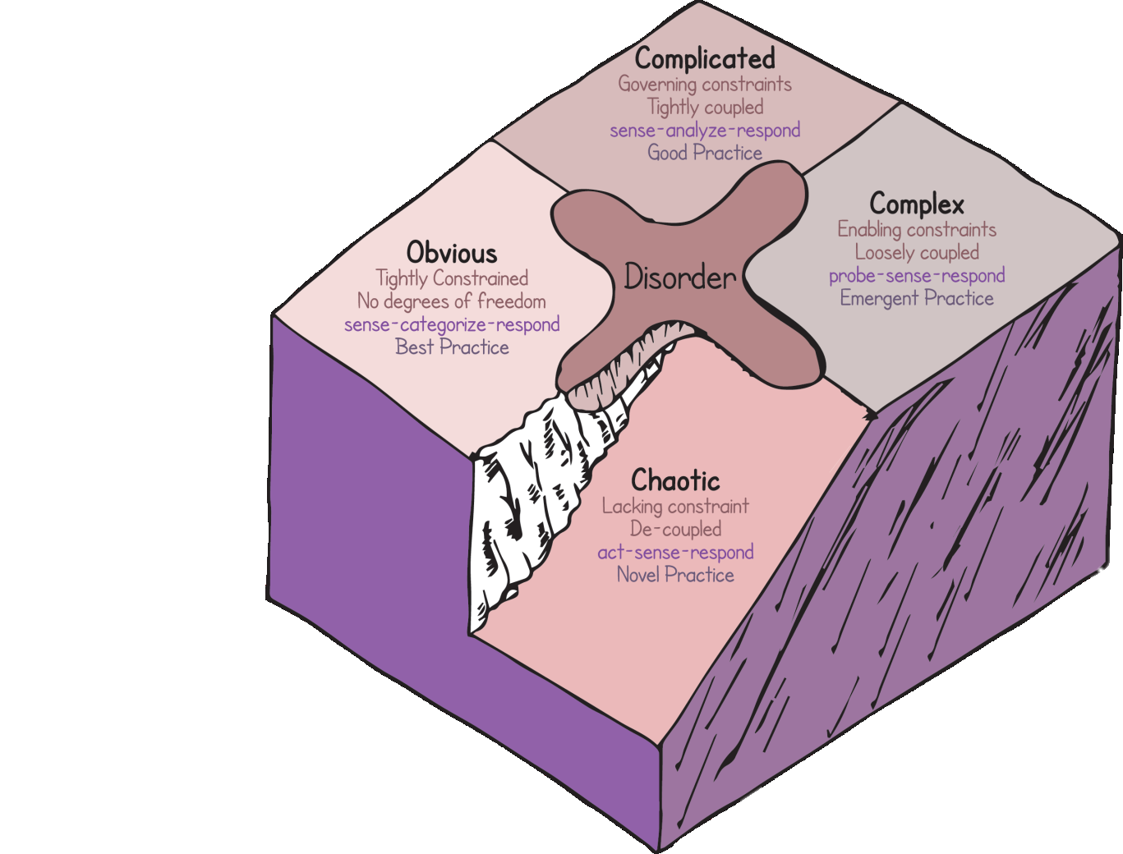
The Cynefin Framework
Five domains
Disorder is the fifth
Can be used to assess the output, outcome or benefit
Can be used to assess the project environment
Collaboratively assessed to avoid people’s natural tendencies
Guidance references: Section 17.4.1, Figure 17.3
Notes:
Syllabus area
Learning Outcome 5
Assessment Criteria 5.6
NB: the diagram is created by AXELOS and you won’t see any other representations like this on the Internet!
As a trainer you need to fully understand this chapter in the book and understand that the context is about assessing the complexity of the output (e.g. it is highly innovative) or the project environment (e.g. we are working in six different time zones and we never worked with any of these people before).
The trainer will need to understand what the cliff represents.
NB: The diagram goes clockwise which is the opposite way to most representations of this diagram.

Slide 43
Cynefin
Projects will typically exist in the Complicated or Complex domains
If work exists in the Obvious domain it will probably be handled as Business As Usual
If work exists in the Chaotic domain it will probably be unsuitable for existing processes
Guidance reference: Section 17.4.1
Notes:
Syllabus Area
Learning Outcome 5
Assessment Criteria 5.6
The main use of the framework would be to discerning when a piece of work is in the complex or complicated domain. For example if it is in the obvious domain it will be handled as BAU. Keep referring to cause and effect: this is how the categories are defined.

Slide 44
AGILE and the PRINCE2 Themes
Some themes are more prominent than others when combining PRINCE2 with agile.
All 7 themes need to incorporate agile
Notes:
Syllabus area
Learning Outcome 5
Assessment Criteria 5.5
Re-emphasise that nothing in PRINCE2 is removed; it is tuned, configured, tailored. Point out that some themes are more prominent than others because of the very nature of agile; e.g. it is very much delivery-focused so themes such as progress and plans have a high level of interaction. The risk theme is less prominent in agile. Please note the word less as opposed to non-existent.

Slide 45
Business case – general view of agile
It may not exist in some agile environments as there may be a focus on value assigned to features instead
May be created at the beginning of a piece of work as part of ‘sprint zero’ (or similar term)
Guidance reference: Section 9.2
Notes:
Syllabus Area
Learning Outcome 5
Assessment Criteria 5.5
This is the first theme to be discussed in the slide deck and the trainer should tell delegates that each theme will be presented in the form of the general view followed by guidance.
The general view of agile with respect to the business case depends on the maturity of the agile organisation: a business case may exist or it may not. The word value is very prominent in the agile space although ironically many people find it hard to define or describe exactly what it is. The manual does address this and discussion about value will follow shortly. Value is very similar to the word benefits although the trainer needs to be careful as they are not identical. Scrum and Kanban do not have a business case.

Slide 46
Business case - guidance
The business Case may be affected by the amount being delivered
Early delivery of benefits will affect the business case
The minimum viable product (MVP) will need to be clearly stated
Project viability is not the same as the MVP
Best-case, worst-case and expected-case will relate to the amount of features delivered
Where there is high uncertainty this may take very little time.
Guidance reference: Section 9.3
Notes:
Syllabus Area
Learning Outcome 5
Assessment Criteria 5.5
The business case may be built around the early delivery of benefits, i.e. if all the benefits are delivered after the project, the project may not be viable. It is essential to understand the concept of MVP in PRINCE2 Agile because it is to do with learning and not the commercial viability of a product which its name may imply.
The trainer should check the definition of MVP in the glossary and if still unsure, do further reading regarding the MVP in the Lean Startup.
Generally the best case worst case and expected case scenarios relate to how much is being delivered and not how late or how early the project as a whole is delivered.

Slide 47
Defining value
Can often be subjective
Easier to assign relative values
Value can be assessed in many ways
e.g. revenue, reducing costs, customer satisfaction
There is a need to differentiate between output, outcome and benefit
Outcome and benefit need to be measurable
The business case should be flexible to maximise the benefit
Focussing on benefits is helped through collaboration
Guidance reference: Section 9.4.1
Notes:
Syllabus Area
Learning Outcome 5
Assessment Criteria 5.5
Relative value relates to subjective values where it is possible to value one feature as a 10 and a another feature as a five, although the actual value that will be delivered may not be known or hard to quantify.
When training it is important to be consistent when using the word value in the sense that agile refers to value and PRINCE2 refers to benefits. Again as part of learning it can sometimes be a good idea to ask delegates what they think value is, it usually sparks a debate.

Slide 48
Requirements and user stories
They need to be well defined and prioritised so that they are conducive to the agile way of working
Many terms describe what a product does or how well it does it, e.g. Requirement, product description, user story
Definitions should be at the right level and decomposed at the right time allowing then to evolve
Boulders, rocks and gravel as a metaphor
Guidance reference: Section 25.1
Notes:
Syllabus Area
Learning Outcome 5
Assessment Criteria 5.5
It is quite common that many people use different terms for the same thing, e.g. feature requirement user story function. Not only this but it is quite possible that people using the same word to mean different things. Generally speaking agile is not that consistent in this area and PRINCE2 Agile is reasonably relaxed about precise terminology but does summarise this in table 25.1.
It should be noted that requirements is one of the five focus areas as PRINCE2 doesn’t provide enough detail on this to run in an agile context.
The following slides are important to PRINCE2 Agile because many of the failings of current projects are through badly written requirements and/or user stories.

Slide 49
User Stories
Similar to requirements
Additional information would include:
Acceptance criteria
Effort involved
Value
They are a starting point and not fully defined
As a <role>, I want to <function>, so that <benefit>.
Guidance reference: Section 25.6.1
Notes:
Syllabus Area
Learning Outcome 5
Assessment Criteria 5.5
User stories are a starting point and are deliberately not fully defined so that a conversation has to take place.
The hardest part is defining the benefit. Perhaps try some simple examples and see if the delegates can finish them off.

Slide 50
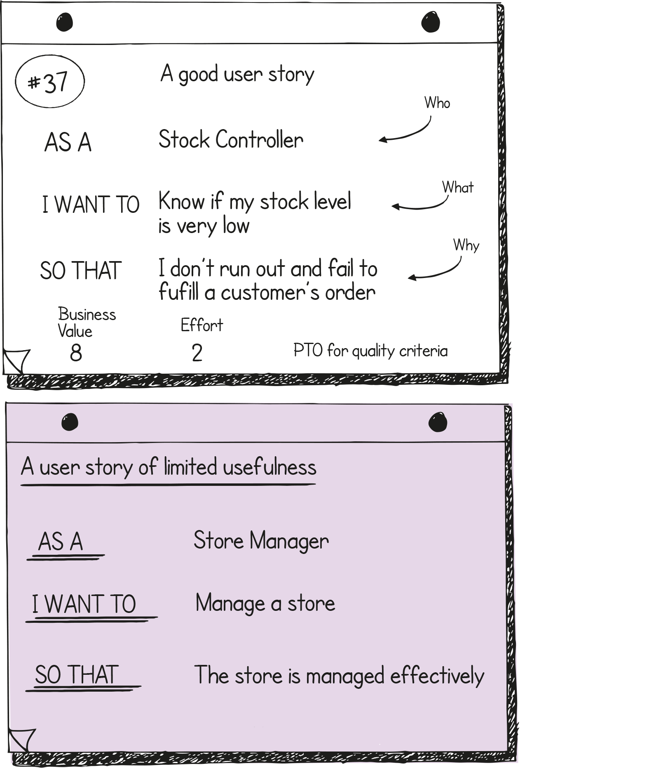
User Stories
Takes skill to create good User Stories:
INVEST is used by many
So is a definition of ‘Ready’
Epics are a type of User Story that need to be broken down
Technical Stories can be used for Non-functional requirements, e.g. performance or speed
Guidance reference: Section 25.6.1.6, Figure 25.3
Notes:
Syllabus Area
Learning Outcome 5
Assessment Criteria 5.5
The purple example is based on a true user story
INVEST – independent, negotiable, valuable, estimable, small, testable
Ready – criteria to decide is a story is written well enough to be worked on in a sprint

Slide 51
Requirements Prioritisation
An essential part of PRINCE2 Agile
Two approaches frequently used are:
MoSCoW
Ordering (1,2,3,…,n)
MoSCoW stands for:
Must have
Should have
Could have
Won’t have for now
Guidance reference: Section 25.5
Notes:
Syllabus Area
Learning Outcome 3
Assessment Criteria 3.1
Sometimes explaining why Moscow is used as opposed to simply putting everything in order of importance is often difficult. One important point is the fact that Moscow relates to a deadline where time is finite and therefore everything will not get done. However, because the work is complicated and of routine there will be groupings of functions and dependencies therefore you do not do the most important things first. For example you do not build a house by starting with the roof which may be the most important part.
The W for won’t is described differently by many people but in PRINCE2 Agile it is ‘won’t have for now’.

Slide 52
MoSCoW prioritisation
MoSCoW – Must, Should, Could, Wont have for now
What makes a Must a Must?
…and a Should a Should
…and a Could a Could
Guidance reference: Section 25.5.2, Table 25.3
Notes:
Syllabus Area
Learning Outcome 3
Assessment Criteria 3.1
There is detailed information on MoSCoW later in the course as well as an exercise but it may be worth mentioning an overview of MoSCoW at this point. An easy training point to make is to ask the delegates about how a customer may prioritise their requirements. Delegates normally respond by saying ‘they will all be musts’. At this point, use the guidance in the manual to explain what makes a must a must.
Would you go on holiday without a T-shirt?
Would you go on holiday without a passport? (Make sure you pick a country that needs a passport if you are using this example)
Explain that we will look MoSCoW in more detail later.

Slide 53
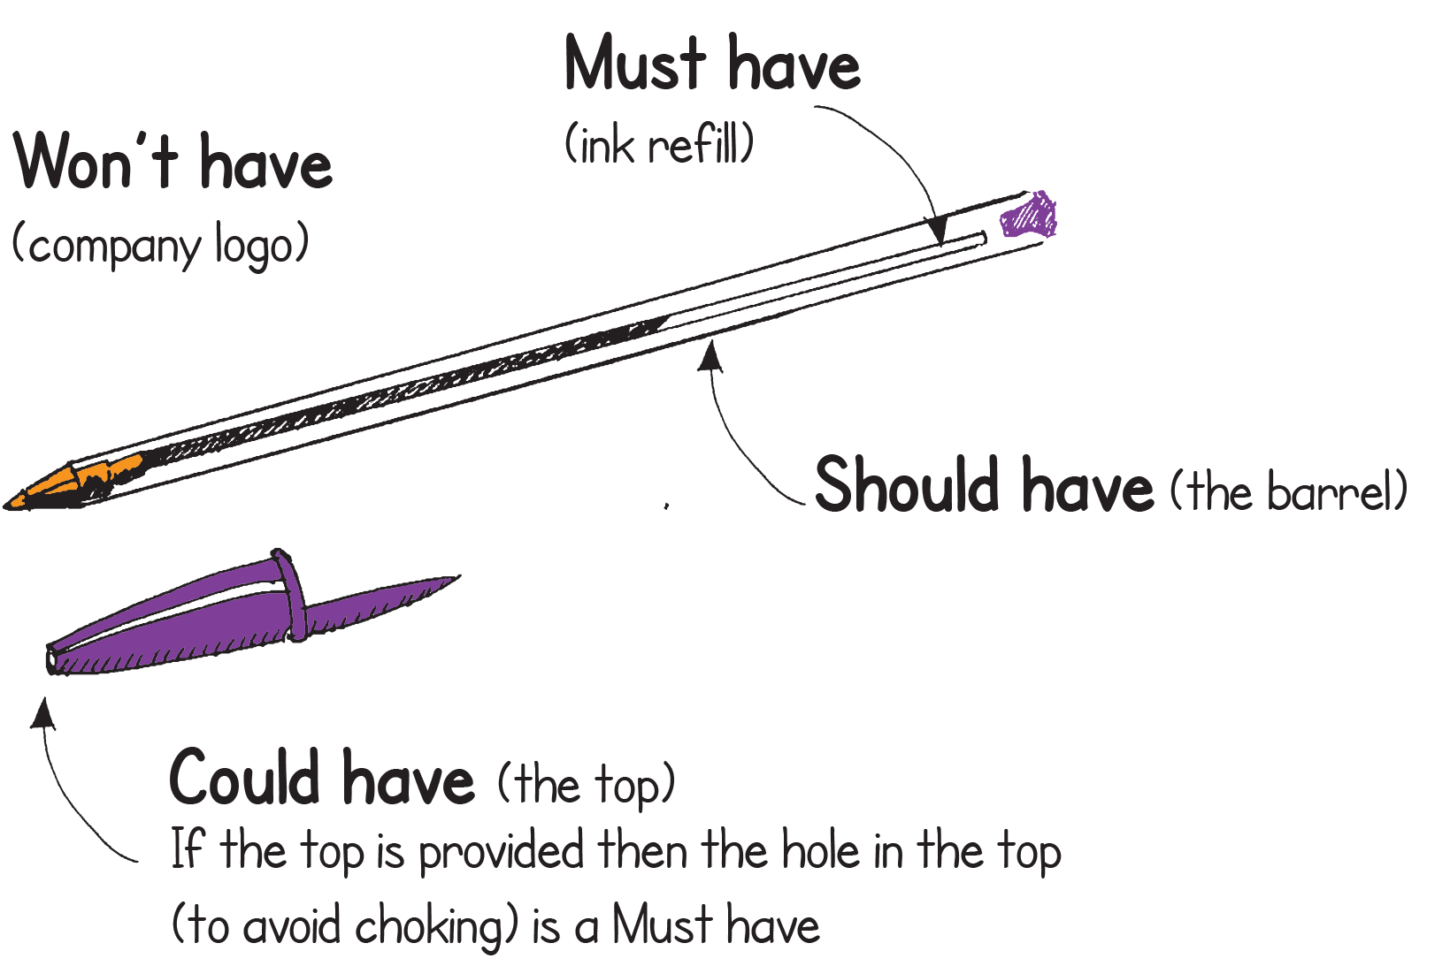
MoSCoW and ordering
Is it really a Must?
Will it work without it?
Is it worth delivering it, without it?
Can it be decomposed?
Ordering is appropriate when:
There is little dependency between items
Items do not naturally group together
Guidance reference: Section 25.5.6, Figure 25.2
Notes:
Syllabus Area
Learning Outcome 3
Assessment Criteria 3.1
If you have the right pen it is best to do this yourself in front of the delegates

Slide 54
Using prioritisation
Can be used on:
Non-functional requirements
Quality Criteria (Acceptance Criteria)
Quality Review activities
Prioritisation handles change but is it detail change or baseline change?
Detail change can be handled dynamically
Guidance reference: Section 25.5.7
Notes:
Syllabus Area
Learning Outcome 3
Assessment Criteria 3.1
PRINCE2 refers to quality criteria whereas the same thing in agile is called acceptance criteria. And in PRINCE2 acceptance criteria relates to CQE.
When training ‘requirements’ it is important is to fully understand non-functional requirements as they are wide and varied and cover anything from a response time to maintainability.
Remember prioritisation enables what is being delivered to the managed and therefore deadlines hit, change responded to and quality protected.

Slide 55
Change – general view of agile
Agile embraces change
Agile responds to it, welcomes it
Change to the detail is typically viewed as positive
Change to the baseline may not be
Guidance reference: Section 14.2
Notes:
Syllabus Area
Learning Outcome 5
Assessment Criteria 5.5
This can be a tricky area because deep down it could be said that PRINCE2 is not really change friendly whereas agile is…. But in truth this is the extremes of the views and the trainer should draw out the message that in effect the two approaches are in fact complementary here: namely we do need to embrace change but it needs to be in a controlled way.

Slide 56
Change - guidance
PRINCE2 could be said to be more cautious
Blending with agile controls significant change
Allows responsive change at the detail level
This typifies the marriage of the two
It is important that baselines use the correct level of detail
Starting-up a project and initiation a project can create the correct environment for this
Guidance reference: Section 14.3
Notes:
Syllabus Area
Learning Outcome 5
Assessment Criteria 5.5
The baseline is being referred to, means that an appropriate level of detail needs to be defined at the right time. Too much detail too early is not good, but equally too little is also not good.

Slide 57
Change - guidance
Requirement definition can be binary or like a spectrum
Good risk management can lessen the impact of change
So can good configuration management
Empowered self-organizing teams at the delivery level handle change dynamically within defined tolerances
Guidance reference: Section 14.3
Notes:
Syllabus Area
Learning Outcome 5
Assessment Criteria 5.5
It is hard to embrace change when requirements are written in a black and white style. Perhaps the whole requirement could be de-scoped but a useful option is to define requirements in a more flexible way so that quality criteria can be used to enable flexing what is delivered.

Slide 58
The Feedback Loop
Gather feedback as quickly as possible
Ideally ‘true’ feedback from the end customer
Many forms of feedback loop exist such as:
OODA, (Observe Orient(ate), Decide, Act)
PDCA (Plan, Do, Check, Act)
PDSA (Plan, Do, Study, Act)
Build, Measure, Learn (Lean Startup)
Guidance reference: Section 14.4.1
Notes:
Syllabus area
Learning Outcome 5
Assessment Criteria 5.5
PRINCE2 Agile tries to focus strongly on an agile concept of feedback and by including Lean Startup, it tries to create a very aggressive full on view that the feedback loop with the customer should be as short as possible in order to iterate and learn fast, and be as agile as possible with iterative and incremental delivery. So many other concepts such as those mentioned on the slide try to do exactly that.

Slide 59
Organisation – general view of agile
Self-organizing
Two common roles:
Scrum Master
Product Owner
Less prominence for:
Project Manger/Team Manager role
Requirements Engineer/Business Analyst (or similar) role
Guidance reference: Section 10.2
Notes:
Syllabus area
Learning Outcome 5
Assessment Criteria 5.5
This theme is one of the bigger areas to fully get right when combining PRINCE2 with agile. It may be obvious but when bringing two different styles and frameworks together, a lot of the considerations are organisational, i.e. so who does what and where does that fit in?
The PRINCE2 Agile view of self organisation is that it is highly desirable but it should not be mistaken for self direction or anarchy. How a team gets from A to B is very much up to the team but the team should not end up at C.
This is another good place to learn from the delegates what they are doing with common agile roles, such as product owner and scrum master. It is also a good idea to understand what views they are have about the project manager role as some agile thinking sees it as redundant and/or obsolete.
PRINCE2 is generic to any project therefore when training PRINCE2 Agile care should be taken not to continuously reference roles such as the business analyst as it may give off and IT bias.

Slide 60
Organisation - guidance
In simple terms adding PRINCE2 roles to agile delivery roles is quite straightforward
However, how easy it is depends upon the nature of the work
Roles need to be aligned
Guidance reference: Section 10.3, Table 10.1
Notes:
Syllabus Area
Learning Outcome 5
Assessment Criteria 5.5
Mapping agile roles to PRINCE2 is easier if there is only one team. On more complex projects using more than one team, it is not straightforward; e.g. the role of product owner.

Slide 61
Organisation - adjustments
Common agile concepts may need to be adjusted
Agile teams prefer to be led and coached as opposed to managed
Mapping the Team Manger roles needs to be handled appropriately
Common agile guidance refers to a single Product Owner
PRINCE2 Agile recommends taking a more blended view
Common agile guidance does not have a Project Manager role
PRINCE2 see this role as mandatory on a project
The Team Manager role needs to integrate into an agile delivery team
Guidance reference: Section 10.4
Notes:
Syllabus area
Learning outcome 5
Assessment criteria 5.5
A complicated area to train is with respect to integrating an agile delivery team into a PRINCE2 environment because it depends on how agile the delivery team is or thinks it is. As an example, if a scrum team is working very effectively it could be damaging to install a team manager (or the role itself) in a form that will disrupt the delivery team. This needs to be handled with care, and the manual describes three options which should be carefully understood by the trainer as this interface is so important to get right.
Unfortunately some of the problem exists in the land of ‘pink and fluffy’ where people go a bit funny when they hear the word ‘managed’ and start to froth at the mouth. It is important when training PRINCE2 Agile to get a good blend of sensible pragmatism and avoid the extremes of command and control or ‘happy clappy rules OK’.
In simple terms it could be said that scrum is based on a one product, one team, one product owner scenario and therefore any project (above a very simple one) will not work straight out of the box.
The only time you do not need a project manager is when it is not a project, e.g. when it is BAU.

Slide 62
Organisation
How the Project Manager relates to the delivery team is key
There are 3 options:
Leave the delivery team roles as they are
Leave the delivery team roles as they are but identify a single point of contact for the Project Manager
Create a Team Manager role in the delivery team
The choice will be made according to the circumstances of the project
Guidance reference: Section 10.4.2
Notes:
Syllabus area
Learning Outcome 5
Assessment Criteria 5.5
These options could be seen as a range... From ‘very agile’ at the top to ‘less agile’ at the bottom

Slide 63
Organisation – the delivery team
Usually represented by some or all of the following:
Someone to lead the team
Someone from the customer (or at least someone to represent the customer)
A team to create the product
Someone to assure the quality of the product
Someone to coach the team (which includes coaching them in agile)
Multi-skilled ‘generalising specialists’
Guidance reference: Section 10.4.3
Notes:
Syllabus Area
Learning Outcome 5
Assessment Criteria 5.5
It could be said that the concept of a delivery team is missing from PRINCE2 as PRINCE2 focuses on project management and not product delivery. Therefore PRINCE2 Agile includes role definitions that could be used when needed, if other terminology from other frameworks, e.g. the product owner role in scrum, is not sufficient. The only other method that addresses this in agile is probably DSDM.
The trainer needs to be clear on what a ‘generalising specialist’ is as some in the agile community promote the idea of teams that are truly multi skilled which triggers the debate about whether or not this is a good situation, in the sense that a team of all-rounders may be able to work on each other’s work but they have generally lower levels of expertise where it is needed. Using a sports team as an analogy may be useful here, e.g. cricket or football.

Slide 64
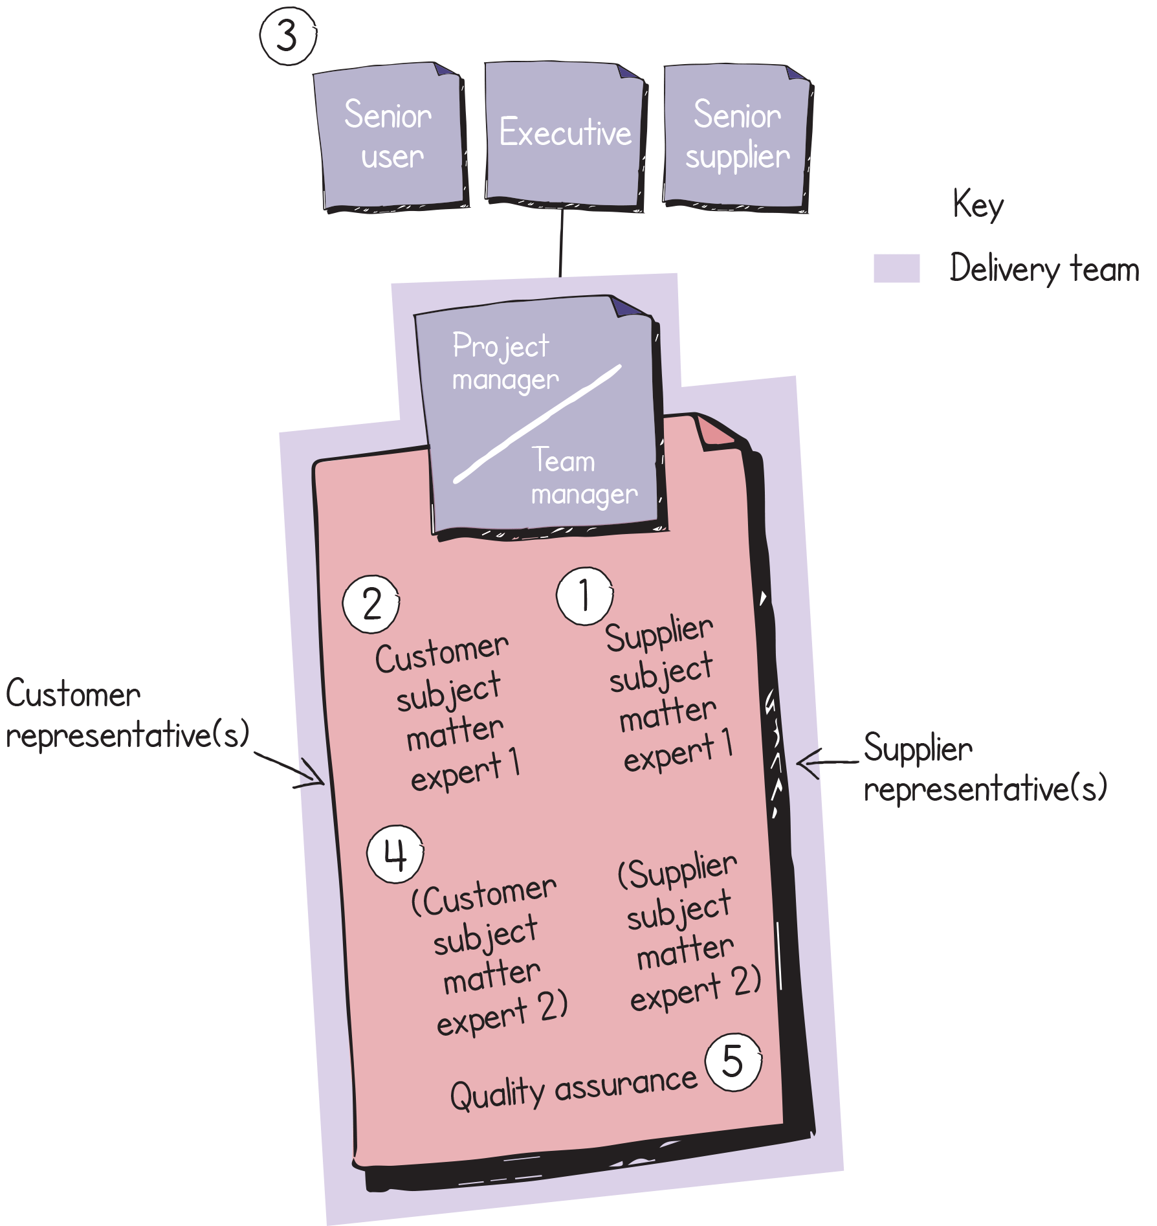
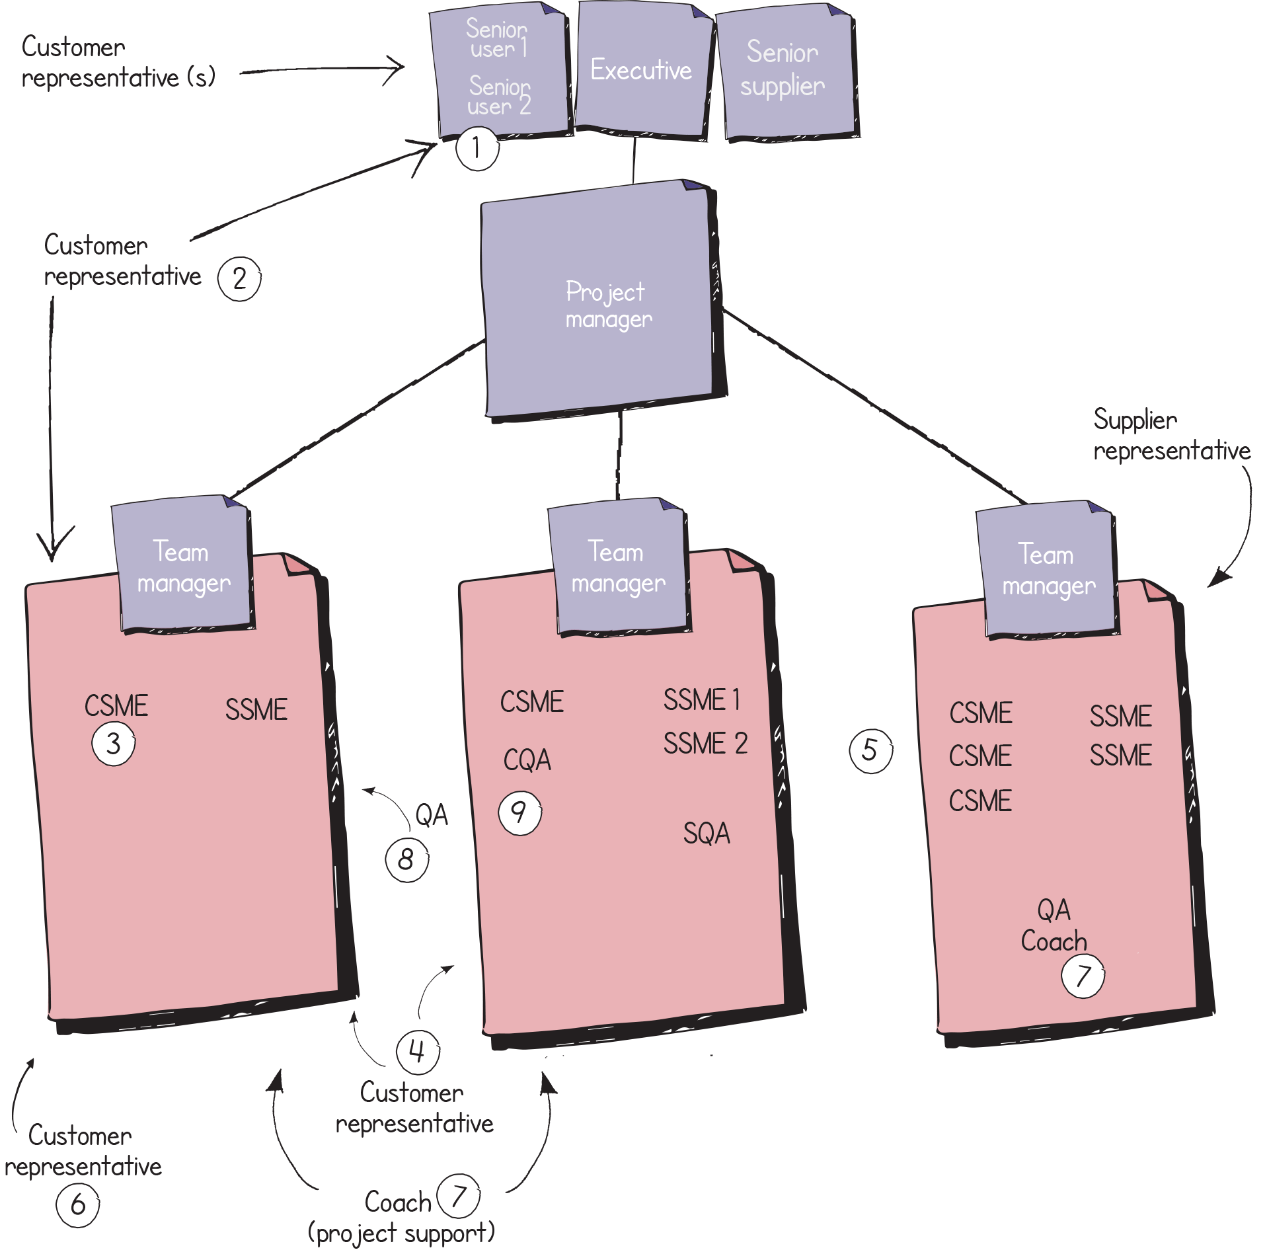
Organisation – project structures
All roles need to be conversant with working in an agile way
Guidance reference: Figure 10.4, Figure 10.5
Notes:
Syllabus Area
Learning Outcome 5
Assessment Criteria 5.5
The colouring and three levels relate to the previously described layer cake.
If you have one team then the PM is the TM.

Slide 65
Servant Leadership
Usually seen as best practice for leading an agile team
The best way to lead a team is to be its servant
Some of PRINCE2 could be said to be in conflict with this
The focus is on:
Empowerment
Collaboration
Facilitation
How much this can be used depends on context
Nothing in PRINCE2 limits the use of Servant Leadership
Guidance reference: Section 10.5.1
Notes:
Syllabus area
Learning Outcome 5
Assessment Criteria 5.5 /5.6
This can be another hot topic when dealing with some people in the agile community as it can become controversial when servant leadership is debated on the extremes. The chapter in the manual was reviewed by an expert in servant leadership and was described as ‘a balanced view’. Some people who are strong advocates of servant leadership see management as divisive and unnecessary. Generally most people advocate this style of leading an agile team but this is done with a degree of pragmatism. This is why some people describe it as facilitative leadership. A particular stumbling block with many in agile is that the word servant is seen but the word leadership is not, and when things go well in a team, all is fine but when things go wrong that can be a different story.
When training this section it is important to realise some views on this can be quite emotive. Steering a pragmatic course and avoiding extremes would be advisable because fundamentally some parts of PRINCE2 could be said to go against this. However PRINCE2 does not prohibit or promote any specific sort of leadership.

Slide 66
Incorporating a wider Customer view
The simplicity of the Product Owner role has limitations in a project context such as:
Project size
Size of the role
The detailed view and the wider, higher level view needs to be reflected
A specialist role can be used to define requirements
Senior User is ultimately responsible
The Product Owner operates best from inside a delivery team
Guidance reference: Section 10.5.2
Notes:
Syllabus area
Learning Outcome 5
Assessment Criteria 5.5
Some agile approaches have a very restrictive view of the customer, e.g. the product owner role in scrum (restrictive in the sense that there is only one role representing the customer) it is seen as having advantages because it is one point of contact but in a complex and multifaceted project this is not always an ideal scenario therefore PRINCE2 Agile tries to ensure a wider view of the customer’s presence on a project. This wider view would cover high level requirements and detailed requirements and requirements from specialist areas that need to be reflected in the project.

Slide 67
Working Agreements
Used to evolve the effectiveness of a team
Typically they are made visible
Collaboratively defined, built by consensus
Need to be built with care
Guidance reference: Section 10.5.3
Notes:
Syllabus area
Learning Outcome 5
Assessment Criteria 5.5
Everyone agreeing how to do something is a good idea. But how to execute or manifest this can be tricky in the sense that a set of rules can be seen positively as guidelines or negatively as bureaucracy.

Slide 68
Principles and behaviours
All PRINCE2 principles are applicable when using agile.
PRINCE2 Agile identifies 5 behaviours to be monitored.
Agile has a strong focus on principles (see Appendix E).
Guidance reference: Appendix E
Notes:
Syllabus area
Learning Outcome 5
Assessment Criteria 5.2
In general the topic of principles and behaviours is a huge area and much is said and written about it in an agile context. It could be said that if there was only one thing to get right, this would be it. Unfortunately the wide variety of methods and approaches refer to a mixture of principles and behaviours, and also refer to them with other terms such as values and mind-sets. In PRINCE2 Agile this whole group of attitudes and ethos is seen as behaviours. Therefore the seven PRINCE2 principles are complemented by the five behaviours that would typify agile in a PRINCE2 context.
When training this area it may be appropriate to avoid distinctions between what is a principle and what is of value as definitions often overlap and contradict.

Slide 69
PRINCE2 Principles - guidance
Continued business justification
The rationale behind the MVP should be understood
Learn from experience
Many agile concepts support this and should be used
Defined roles and responsibilities
Delivery roles will apply and should be carefully mapped
Manage by stages
Timeboxes should be integrated carefully
Manage by exception
This is at the heart of empowering people with the appropriate level of governance
Focus on products
This makes it easier to stay in control and focus on value
Tailor to suit the project
Further specific tailoring is enabled by assessing the risks associated with agile
Guidance reference: Section 7.3, Table 7.1
Notes:
Syllabus Area
Learning Outcome 5
Assessment Criteria 5.2
Table 7.1 give some ideas of simple guidance for the principles and possible examples. Some of the PRINCE2 principles are very relevant to agile and a key message to convey is that manage by exception is a very powerful principle to apply to agile as it empowers people to self organise and allows them to deliver.

Slide 70
PRINCE2 Agile Behaviours
Transparency
Collaboration
Rich Communication
Self-organization
Exploration
The 5 behaviours are:
Guidance reference: Section 7.4, Figure 7.1
Notes:
Syllabus Area
Learning Outcome 5
Assessment Criteria 5.2
Table 7.1 gives some ideas of simple guidance for the principles and possible examples. Some of the PRINCE2 principles are very relevant to agile and a key message to convey is that manage by exception is a very powerful principle to apply to agile as it empowers people to self organise and allows them to deliver.

Slide 71
The Agilometer – a focus area
An assessment tool providing guidance on risks and benefits from an agile perspective
Assessed at the start of a project and throughout
The project manager facilitates the assessment
It is a guide to make an informed decision
Use the sliders in isolation, do not create an average
After the assessment, can any sliders be improved?
The question is always ‘how much’ and not ‘yes or no’
Guidance reference: Section 24.1, Section 24.2, Section 24.3
Notes:
Syllabus Area
Learning Outcome 3
Assessment Criteria 3.1 and 3.2
Essentially this is a risk assessment for how appropriate agile is for a given project. The name may be seen as somewhat quirky but the team working on PRINCE2 Agile generally wanted something lighter to describe some of the key areas that are important when combining PRINCE2 with agile (another example of this is the use of the terms fix and flex).
A very good possibly counterintuitive learning point is to ensure that when the sliders are used on the agilometer they are not averaged out as this will tell you absolutely nothing and may hide something absolutely vital. This links into ‘how much agile’ as opposed to agile ‘yes or no’.
It is only a guide and organisations should evolve their own version of the agilometer for assessing agility on a project.

Slide 72
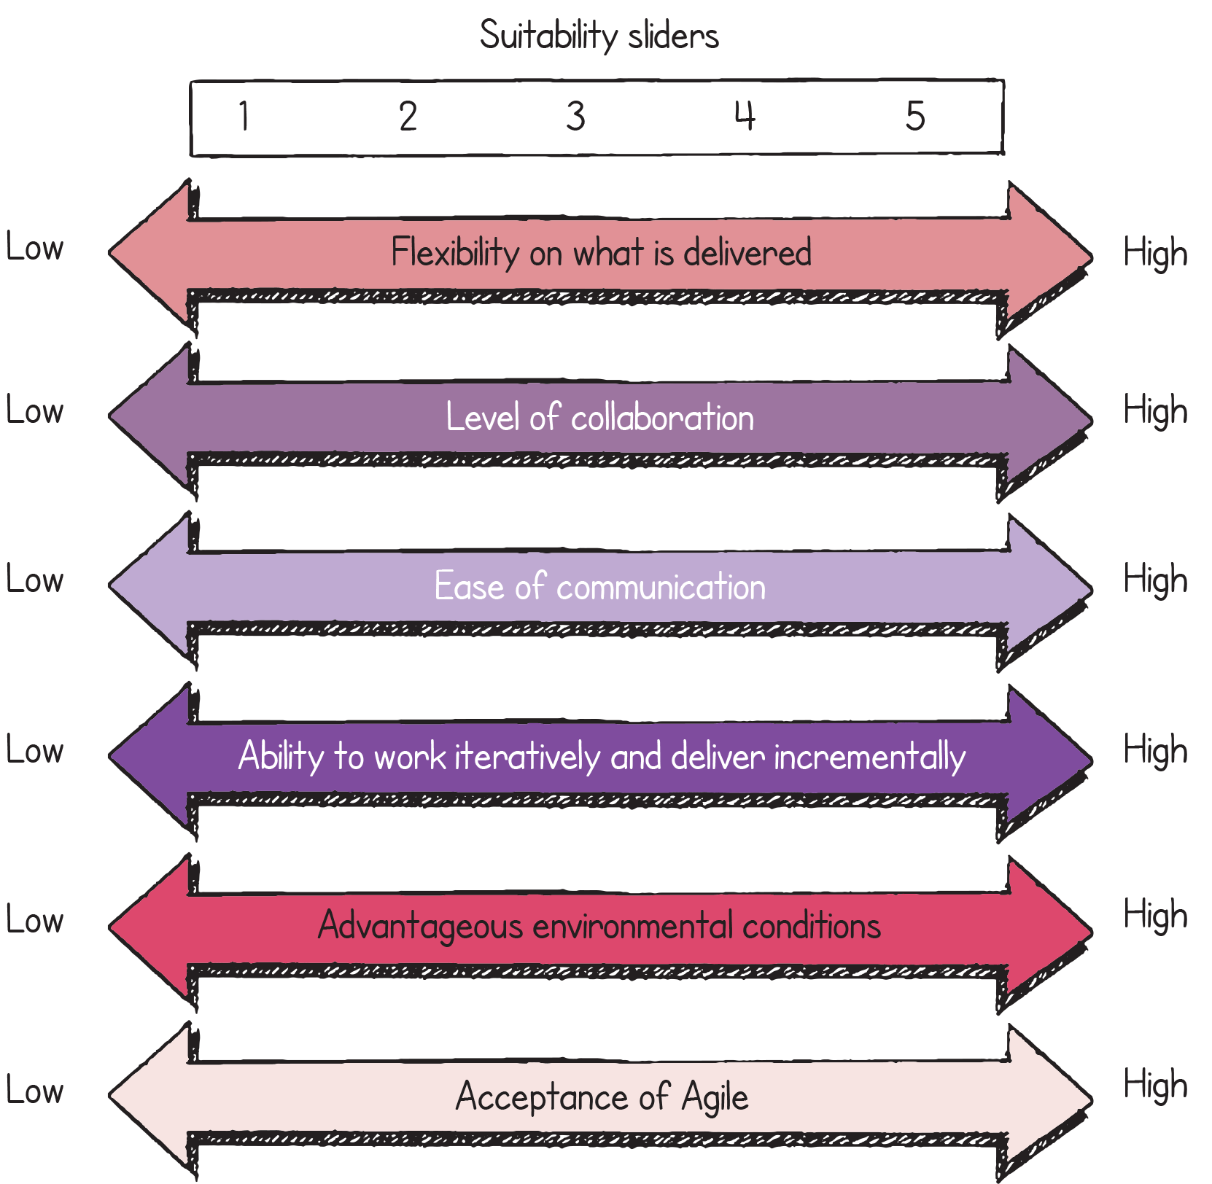
The Agilometer
The Agilometer in PRINCE2 Agile has 6 key areas
This represents a starting point, it can be tuned
Guidance reference: Section 24.4, Figure 24.1
Notes:
Syllabus Area
Learning Outcome 3
Assessment Criteria 3.1 and 3.2

Slide 73
RISK
Generally there is relatively less prominence given to the area of risk in agile
Agile concepts mitigate many risks associated with other approaches (e.g. waterfall)
PRINCE2 brings a level of formality and planning to risk management
The level of formality should be appropriate
Address risk during stand-up meetings
Agile has risk areas of its own (assessed by The Agilometer)
The 5 behaviours in PRINCE2 Agile help manage risk
Guidance reference: Section 13.1, Section 13.2
Notes:
Syllabus Area
Learning Outcome 5
Assessment Criteria 5.4 and 5.5
The risk theme is a good example of a theme that has very little relative prominence in what is written and said about agile. There are many in the agile community who see agile as removing (all) risk from a project. When training risk with respect to agile it should be made clear to delegates that agile comes with its own set of risks e.g. what if the customer engagement on the project is not there or is likely to drift away.
It may be a worthwhile debate with delegates to talk about what risks agile removes in comparison to waterfall and what does it introduce. It could be said that there is very little formal risk management in most of what is written about agile. PRINCE2 does bring something to the party in this respect

Slide 74
Managing Product Delivery
A strong focus in this area
Managing product delivery
Product delivery practices
Scrum manages product delivery
Kanban can be used here too (to organize it?)
What you may find
Guidance reference: Section 20.2
Notes:
Syllabus Area
Learning Outcome 5
Assessment Criteria 5.5 and 5.6
MP focuses on product delivery and this is where many agile frameworks and techniques exist. Strictly speaking MP is about managing the interface to product delivery. Incorporating agile into PRINCE2 provides a product delivery element. Delivery teams using scrum or Kanban would be inside this process.

Slide 75
Managing Product Delivery
Use work packages appropriately
It is a vital interface/link to be managed
Perhaps define tolerances on what is delivered at the Work Package level
Ensure that product descriptions are defined at the right level
Agree and/or give guidance on such areas as quality, releases and risk.
What to do
Guidance reference: Section 20.3
Notes:
Syllabus area
Learning outcome 5
Assessment Criteria 5.5 /5.6
The crafting and use of work packages is very significant in PRINCE2 Agile, it could be said they are THE interface. There are many mechanisms in a work package that can help with agile such as tolerances.

Slide 76
Managing Product Delivery
Work packages are collaboratively defined
Reporting arrangements have an appropriate level of formality and transparency
The wider project context is understood
How it might look
Guidance reference: Section 20.3
Notes:
Syllabus area
Learning Outcome 5
Assessment Criteria 5.5 and 5.6
Defining a work package can be done in several ways. How the interface between the PM and TM is handled is an area of discussion that needs to be handled carefully, as there are many ways to do this. One approach that would not be very agile is for the PM to create a work package and deliver it to a delivery team (or TM); this would be seen as un-agile. How far a collaborative approach to work package definition can go depends on projects situations, but the key PRINCE2 Agile point here is that they should be collaboratively defined.

Slide 77
Work Packages
A vital interface to blend to the project environment
Collaboratively defined
Agreed levels of detail and formality with respect to reporting, tolerances, product descriptions and quality criteria
Guidance on behaviours, risk and the frequency of releases
Guidance on quality checking techniques
Guidance reference: Section 20.3
Notes:
Syllabus area
Learning Outcome 5
Assessment Criteria 5.5 and 5.6
The level of formality can be quite wide and varied and would depend on the project circumstances.

Slide 78
AGILE METHODS WITHIN WORK PACKAGES
Agile methods can be used to deliver Work Packages:
Scrum
Kanban
Lean Startup
Guidance reference: Appendix H

Slide 79
Plans – general view
Agile puts a lot of emphasis on planning
Agile mostly uses Empiricism as opposed to Rationalism
Planning style:
Based on features
A team-based exercise
Plan at the last responsible moment
Using a points scoring system to estimate is popular although there are other ways
Guidance reference: Section 12.2
Notes:
Syllabus area
Learning Outcome 5
Assessment Criteria 5.4 and 5.5
The trainer should be able to explain the difference between empiricism and rationalism.
Many people experienced in agile will immediately think of story points and planning poker at this point but again this is ‘a way’ not necessarily ‘the way’.

Slide 80
Plans - guidance
PRINCE2 supports any planning style
A PRINCE2 project needs an end date
Both agile and PRINCE2 accept the premise of planning horizons
Higher level plans may be more conventional but this is not mandatory
Product-based planning can be used easily for any level of plan (see Appendix D)
Planning needs to consider dependencies and grouping similar work items
Guidance reference: Section 12.3
Notes:
Syllabus area
Learning Outcome 5
Assessment Criteria 5.4 and 5.5
A lot of agile planning is carried out in a BAU environment where there is no end date. This will not be the case on a project. Product-based planning goes nicely with agile as agile is product-focused.

Slide 81
Estimation
Using some form of points system is popular
Estimating starts with relative estimates and is carried out as a team
Team members estimates should not be affected by others
Differences are discussed
The Fibonacci sequence or T-shirt sizing are very popular systems
Guidance reference: Section 12.4.1
Notes:
Syllabus Area
Learning Outcome 5
Assessment Criteria 5.4 and 5.5
The training should be familiar with story point estimation and T-shirt sizing and the fact that agile estimation is often team based. Knowledge of the thinking behind the ‘wisdom of crowds’ and something called ‘cognitive anchoring’ would be an advantage here.
One point often overlooked in agile is that relative estimation is a distinctly different step to actual estimation. In simple terms this means that saying a task that is classed as small because it will take two days makes the use of T-shirt sizing redundant as the relative estimation step has in effect been bypassed.

Slide 82
Progress – general view
Similar to plans in that it is of particular importance
Burn charts and WIP boards are commonly used
The bigger picture relates to key agile values (e.g. transparency)
Guidance reference: Section 15.2
Notes:
Syllabus materials
Learning Outcome 5
Assessment Criteria 5.4 and 5.5
A very prominent technique used in agile is the burn down chart showing progress with respect to features done and yet to do. When combining PRINCE2 with agile it is important to point out that this form of information display is being used because it is features that are being managed. On a more classical project where time and cost are being managed a burn down chart may not be so useful. In PRINCE2 Agile, time and cost are fixed therefore a PM is not managing them.
A good discussion point would be to ask for opinions on Gantt charts as there is nothing to stop you using them on a PRINCE2 Agile project. In fact they may be used at the higher levels. It is just that what they are showing in terms of progress is more to do with time and cost rather than scope delivered.

Slide 83
Progress - guidance
What is being delivered is of the most importance
It may take several sprints to understand how things are progressing
In terms of ‘how are things going?’, it is a necessity to be in control at all times
Many agile techniques can be used at any level of a project
The audience for any technique will need to be comfortable with the format
Guidance reference: Section 15.3
Notes:
Syllabus area
Learning Outcome 5
Assessment Criteria 5.4 and 5.5
The trainer should be aware of the term ‘velocity’ as this is commonly used in agile and represents how fast a team is going, in other words how much work they are getting through.

Slide 84
Burn charts
A popular technique that comes in two forms:
a burn-down chart
a burn-up chart
Displayed in the form of a graph with an x and y axis
They show the current situation and the current rate of progress
Burn-down charts assume the amount of work doesn’t change
Burn-up charts should be used if the amount of work is likely to change
They focus on what has been completed
Guidance reference: Section 15.4.1
Notes:
Syllabus area
Learning Outcome 5
Assessment Criteria 5.4 and 5.5
When training burn charts the trainer must be familiar with the difference between the two and be able to talk through the diagrams on the subsequent slide. It is fair to say that the lines on a real burn down chart may not be so squiggly. This has been caused by the branding style of the artwork.

Slide 85
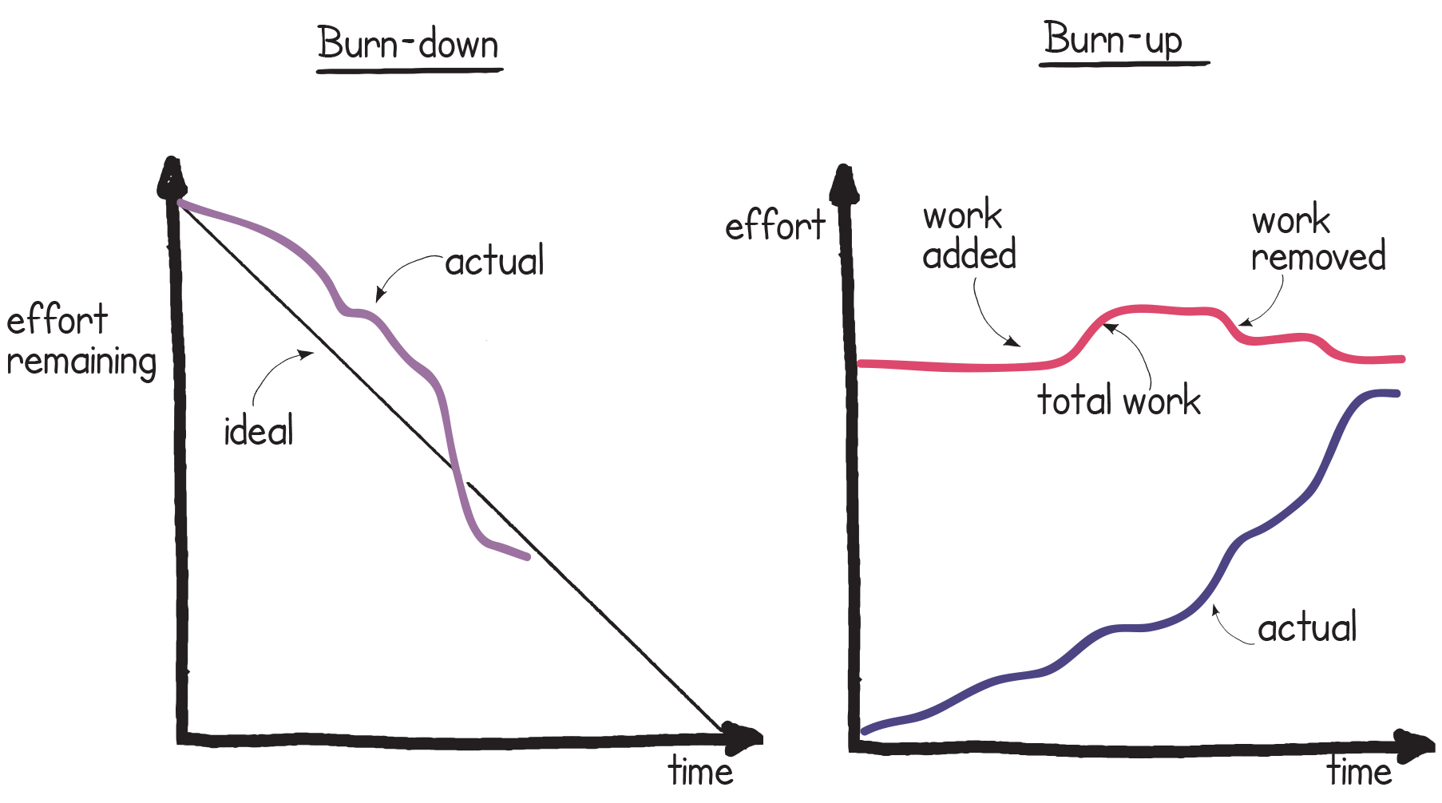
Burn charts
Guidance reference: Section 15.4.1, Figure 15.1
Notes:
Syllabus area
Learning Outcome 5
Assessment Criteria 5.4 and 5.5
This kind of graphic can apply to any duration e.g. a release, 3 month stage.

Slide 86
Information Radiators
Create visual information that can be accessed immediately
Best created and maintained manually
Contribute significantly to transparency
Information is ‘pushed’ as opposed to ‘pulled’
Can display a wide variety of information
Holding a daily stand-up meeting by a display enables it to be updated immediately
Guidance reference: Section 15.4.2
Notes:
Syllabus area
Learning Outcome 5
Assessment Criteria 5.4 and 5.5
IRs are also referred to as big visible charts or BVCs.
You can also refer to them as team boards or information displays when used back at the office!

Slide 87
Quality – general view of agile
In some agile environments there may not be a lot of emphasis given to quality planning and quality management, during the start of a project.
Prominent techniques such as the definition of ‘Done’ and acceptance criteria address quality control
Evolving the definition of ‘Done’ is commonly used
Concepts such as ‘test as you go’ or ‘test first’ are used for testing and quality checking
Guidance reference: Section 11.2
Notes:
Syllabus area
Learning Outcome 5
Assessment Criteria 5.4 and 5.5
The general view of agile is that most of what you read and hear appears lower down the PRINCE2 hierarchy regarding quality.
In the PRINCE2 quality audit trail, there are such concepts as a quality management approach but this is not so prevalent in agile, whereas lower down on the diagram concepts like quality checking and quality criteria are very much represented by agile techniques and concepts where agile acceptance criteria is similar to (if not the same thing as) quality criteria.
A prominent technique surrounds the evolution of the definition of done which is if you like an evolutionary definition of a wider quality level for a project.
When training PRINCE2 Agile it is important to mention that many IT concepts that are seen as agile are in this area (for testing). It is hard to replicate some of the IT concepts in other industries and sectors. An example of this would be TDD and trainers not conversant with IT should be aware of what this is.

Slide 88
Quality - guidance
Product descriptions are flexible (e.g. they can be User Stories)
The project product description purpose would preferably be defined as an outcome
Quality management and quality planning includes:
Which tools and approaches are to be used
The role of the customer (an essential ingredient)
Assessing and costing the resources
Quality control considerations
Guidance reference: Section 11.3
Notes:
Syllabus area
Learning outcome 5
Assessment criteria 5.4 and 5.5
Most agile concepts are geared around managing features but with the changes made to PRINCE2 in 2009 and the use of the hexagon in PRINCE2 Agile there is a lots of flexibility that can be utilised by flexible product descriptions and their quality criteria.
To get quality into products you need customer involvement with agile.

Slide 89
Quality – how to test
Care needed when transferring these concepts from the software development domain
Common agile terms include:
Test-driven Development (TDD)
Behaviour-driven Development (BDD)
Definition of ‘Done’
Definition of ‘Ready’
Refactoring
Technical debt.
Guidance reference: Section 11.3.4
Notes:
Syllabus area
Learning Outcome 5
Assessment Criteria 5.4 and 5.5
As a trainer all six terms on the slide need to be understood to a basic level and how closely they relate to IT.

Slide 90
Quality in relation to Scope
A reduction in scope is not seen by PRINCE2 as a reduction in quality
Customer quality expectations and acceptance criteria are set and this level needs to be maintained
Quality is defined by quality criteria
Scope is defined by the products themselves.
Guidance reference: Section 11.5
Notes:
Syllabus area
Learning Outcome 5
Assessment Criteria 5.4 and 5.5
This is a key point for delegates to understand and some delegates may regard de-scoping as a quality failure. However, agile and particularly PRINCE2 Agile do not see it this way but this viewpoint is held by some, perhaps through some quality initiatives from history (i.e. a decade or two ago).

Slide 91
Managing Product Delivery
Stages may not exist as described in PRINCE2
Container timeboxes e.g. a release
Scrum of scrums
What you may find
Guidance reference: Section 19.2
Notes:
Syllabus area
Learning outcome 5
Acceptance criteria 5.5/5.7
A very tricky area to describe to delegates may be about what a stage is and if there is an equivalent in agile.
The easiest parallel and probably the most typical assumption is that it is similar to a significant release of product(s). There is some truth in this but a PRINCE2 stage is a very specific concept. Above all else it is to do with project justification/viability/commitment of resources and authority to spend and the stage boundary is set in advance without necessarily taking into account technical work.
Therefore the difference between a stage and the value it brings to an agile project should be made clear as PRINCE2 adds value here. It is still possible that a stage may well map to a release but the importance is that the project board are making decisions based on what they are comfortable with regarding management by exception as opposed to what the delivery teams may find suits them in terms of delivery.
Please note that scrum of scrums is slightly controversial as some people like them and some people don’t. PRINCE2 Agile does not think they are a substitute for project management. Specifically they are not suitable to use as a control mechanism. Communication yes. Control no.

Slide 92
Managing Product Delivery
Plan around features
Create flexible Work Packages in order to:
Make management by exception easier
Empower the teams to self-organise
Enable rich communication
Control focusses on what is being delivered
Scope
Quality criteria
Monitor agile risks
What to do
Guidance reference: Section 19.3
Notes:
Syllabus area
Learning Outcome 5
Assessment Criteria 5.6 and 5.7
The slide says it all here!

Slide 93
Managing Product Delivery
Collaborative
Visual
Information Radiators
Stand-up meetings
Demos
Empirical
Inspect and adapt
How it might look
Guidance reference: Section 19.3
Notes:
Syllabus area
Learning Outcome 5
Assessment Criteria 5.6 and 5.7
Although some of this may appear anyway in a normal PRINCE2 project this slide demonstrates further how the emphasis may change in an agile context. But remember, this is at the management level and not the delivery level.

Slide 94
Frequent Releases – focus area
Frequent releases are important when using agile
The advantages are:
Early delivery of benefit
Allows for feedback
Reduces risk (e.g. of delivering the wrong product)
Gives confidence of how the project is progressing
Fosters stakeholder engagement
Makes releasing easier
Needs to be planned (product-based planning can be used)
A release may not go into the operational environment
Guidance reference: Section 27.1
Notes:
Syllabus area
Learning Outcome 3
Assessment Criteria 3.2
One of the five focus areas.
A good training technique here is to ask delegates about the benefits of frequent releases and subsequently it may be worth discussing if there are any disadvantages. The more this can be done and the more frequently it can be done then it could be said the more agile project will be.

Slide 95
Frequent releases
Planned releases would show on project and stage plans
Showing when they will take place
Showing what features are to be released
Different views need to be taken into account when planning releases
The Project Board want to establish appropriate stage boundaries
Early benefits may need to fund later parts of the project
Enabling a product to fail fast, if it is going to fail
Products can be delivered too quickly (leading to disruption)
Releasing into operational use is the ideal situation otherwise a staging area needs to be used which compromises agile to a degree
Guidance reference: Section 27.2
Notes:
Syllabus area
Learning Outcome 3
Assessment Criteria 3.2
When training releases, it is important to understand why you cannot always release into the live (operational) environment and it would be good to give non-IT examples. It may be worth mentioning companies like Amazon and Google who are releasing software several times a day.

Slide 96
Managing a Stage Boundary
What you may find:
Stages may not exist as described in PRINCE2
Viability decisions not usually planned in advance
Similarity between a stage and a release
(where a release is a container timebox)
How things are progressing
How the team and the processes are working
What you may find
Guidance reference: Section 21.2
Notes:
Syllabus area
Learning Outcome 5
Assessment Criteria 5.6 and 5.7
Controlling a stage has many similarities to managing a stage boundary and some of the earlier guidance on controlling a stage applies to SB, e.g. a stage can relate to a release.

Slide 97
Managing a Stage Boundary
What to do:
Assess how much is being delivered
Assess the quality of what is being delivered
What benefits have been realised?
Is agile being use appropriately?
Do the processes need improving?
What to do
Guidance reference: Section 21.3
Notes:
Syllabus area
Learning Outcome 5
Assessment Criteria 5.6 and 5.7
Assessing progress will be represented in the form of what has been delivered as opposed to when, and how much time has been spent in the Timebox. This may be a good time to assess how agile is progressing on the project.

Slide 98
Managing a Stage Boundary
How it might look
Has many similarities to controlling a stage
Visual
Empirical
Inspect and adapt
A point of formality carried out with as little ceremony as possible
How it might look
Guidance reference: Section 21.4
Notes:
Syllabus area
Learning Outcome 5
Assessment Criteria 5.6 and 5.7
See slide

Slide 99
Retrospectives
Reviews the way of working (not what was produced)
A significant technique when working in an agile way
They need to be planned and structured (such as with a workshop)
Covers what went well and what didn’t go so well
Improve little by little, and little and often
Keep them effective by introducing variety
Feedback can come in the form of facts or feelings
Guidance reference: Section 19.4.1
Notes:
Syllabus area
Learning Outcome 5
Assessment Criteria 5.6 and 5.7
A very popular and key technique used in agile. It is important to distinguish this from a product review as retrospectives look at how the process is going with a view to improving it

Slide 100
Directing a project
What you may find will vary according to the level of agile maturity
What you may find
Guidance reference: Section 18.2
Notes:
Syllabus area
Learning Outcome 5
Assessment Criteria 5.6 and 5.7
In some ways DP is difficult to describe in terms of what you will find in an agile environment, because if you have this process in place you probably already have PRINCE2 operating or something very similar to it. So it is worth reiterating to the delegates that PRINCE2 can help a basic environment or a reasonably mature environment with such concepts as project management and project direction. However, as described in sections 3.2, 3.3 and 3.4, it may be that PRINCE2 is not needed because the agile environment has been optimised to run projects correctly.
So, you probably never find an optimal form of DP, as it means you do not need PRINCE2!

Slide 101
Directing a project
What to do
Manage by exception with the emphasis on:
Empowerment
The amount being delivered
Rich information flows
Value being delivered
What to do
Guidance reference: Section 18.3
Notes:
Syllabus area
Learning Outcome 5
Assessment Criteria 5.6 and 5.7
Manage by exception is a very big button to press in terms of the value PRINCE2 can bring to agile. Applied correctly, this should create space for people to be empowered and self organise, which is in effect creating the very environment that agile so much wishes to promote and create. The easy criticism of PRINCE2 is that it is command and control, but the reality is that the correct application of PRINCE2 is to trust and empower.

Slide 102
Directing a project
How it might look
Pulling information rather than having it delivered
Collaborative working
Trusting
Absence of a blame culture
How it might look
Guidance reference: Section 18.3
Notes:
Syllabus area
Learning Outcome 5
Assessment Criteria 5.6 and 5.7
There may be challenges for a project board from a cultural point of view if they do have command and control tendencies. Also it may be worth discussing whether or not a project board would be able to pull information from a project as opposed to having it delivered to them.

Slide 103
Agile contracts
Contracts may need to be created in a way amenable to agile
An issue with traditional contracts is that requirements change and someone will need to allow for this
Trust is important as it determines the amount of risk that is shared
Guidance on structure in order to create the right behaviours:
Guidance reference: Section 28.3
Notes:
Syllabus area
Learning Outcome 5
Assessment Criteria 5.6 and 5.7
This is a focus area and a very specific one. Its intention is to provide some degree of information and stimulate debate as to how contracts could be structured in an agile context, because many people are affected by this or wish to know about this. The chapter does make recommendations and suggestions but it is not within the remit of this manual to go much further or to create a specimen contract.
This does relate to how the hexagon and the five targets work to a degree.

Slide 104
Closing a Project
Defined processes may only exist in mature agile environments
Regular handovers have resulted in activities becoming second nature
What you might find
Guidance reference: Section 22.2
Notes:
Syllabus area
Learning Outcome 5
Assessment Criteria 5.6 and 5.7
Not a lot is written about closing a project in agile and PRINCE2 brings value here, although a project closing in an agile context should be very low on ceremony due to the regular delivery of frequent releases of usable product into operational use.

Slide 105
Closing a Project
Check against the original baseline
Evaluate the use of agile on the project
Ensure the formality of final acceptance is appropriate
Finalise documentation that has been created iteratively and incrementally
What to do
Guidance reference: Section 22.3
Notes:
Syllabus area
Learning Outcome 5
Assessment Criteria 5.6 and 5.7
Documentation would have been created bit by bit, as opposed to all in one go at the end of a project.

Slide 106
Closing a Project
A workshop is used
Benefits are already being delivered
The majority of the information has already been completed
How it might look
Guidance reference: Section 22.4
Notes:
Syllabus area
Learning Outcome 5
Assessment Criteria 5.6 and 5.7
The manual contains an example workshop that the trainer may wish to go through as a way to end the project in a collaborative way with high degrees of communication.

Slide 107
PRINCE2 MANAGEMENT PRODUCTS AND ROLES
Notes:
Syllabus area
Learning Outcome 5
Assessment Criteria 5.5
Re-emphasise that nothing in PRINCE2 is removed; it is tuned, configured, tailored. Point out that some themes are more prominent than others because of the very nature of agile; e.g. it is very much delivery-focused so themes such as progress and plans have a high level of interaction. The risk theme is less prominent in agile. Please note the word less as opposed to non-existent.

Slide 108
PRINCE2 Management Products and Roles
All 26 PRINCE2 management products are in appendix A
The PRINCE2 roles are in appendix B along with the PRINCE2 Agile delivery roles
Guidance reference: Appendix A, Appendix B
Notes:
Syllabus area
Learning Outcome 5
Assessment Criteria 5.6 and 5.7

Slide 109
Tailoring of the PRINCE2 Products
Can exist in a wide range of formats and level of formality
They are not necessarily documents
They may need to include additional information
Some products are significant/important:
Work Package
Highlight Report
Checkpoint Report
Guidance reference: Chapter 23
Notes:
Syllabus area
Learning Outcome 5
Assessment Criteria 5.8 and 5.9
The three products highlighted on the slide have special significance as they represent key interfaces. How they are composed, both in terms of content and physicality, is also important.

Slide 110
Rich communication – focus area
Communication problems need to be proactively addressed
Effective communication is fundamental to agile
Communication takes place in many ways therefore people should interact appropriately
Communication channels:
The written word
Visualisation
Verbally by telephone
Verbally, face-to-face
Guidance reference: Section 26.1, Section 26.2
Notes:
Syllabus area
Learning Outcome 3
Assessment Criteria 3.1 and 3.2

Slide 111
Rich communication
Face-to-face should be favoured as a faster and clearer channel
Technology and the level of formality needs to be assessed
There is a role for the written word but it has disadvantages
A project manager (or team manager) needs to be aware of how a team is communicating
Communication needs to be organised and planned
Guidance reference: Section 26.3
Notes:
Syllabus area
Learning Outcome 3
Assessment Criteria 3.1 and 3.2

Slide 112
Workshops
Harness interactions and creativity
Ideally run by a neutral facilitator who manages the workshop
Preparation is essential
Many tools and techniques exist
Workshops can be used at any point on a project
It is important to get the group dynamics right
Correctly run workshops can create high quality outputs quickly
This leads to clarity, consensus and ownership
Guidance references: Section 26.4.1
Notes:
Syllabus area
Learning Outcome 1
Assessment Criteria 1.1 and 1.3
A common technique used in agile, ideally with a neutral facilitator, but this is not always an option. It can be good to discuss experiences with delegates who have had neutral facilitators, in terms of the value that was added (or not). Bearing in mind that when listening to these experiences they may be reflecting on well run workshops or badly run workshops.
In simple terms a facilitator is responsible for the process and the dynamics but not the content.

Slide 113
SCRUM
Notes:
Syllabus area
Learning Outcome 1
Assessment Criteria 1.1
This section looks at the Scrum product development method.

Slide 114
Scrum – what is it?
A framework for developing and sustaining complex products
A collection of roles, events, artefacts and rules
Created by Schwaber and Sutherland (c. 1995)
A way to assess the efficiency of your practices so that you can improve
Guidance reference: Appendix H
Notes:
Syllabus area
Learning Outcome 1
Assessment Criteria 1.1
The next group of approximately 7 slides provide training on scrum according to the scrum guide which is seen as the definitive definition of scrum. It is essential that the trainer is familiar with the basic concepts of scrum and the good news is that it is conceptually very simple to understand and with the scrum guide only being 15 pages it can be picked up very quickly. Anyone training PRINCE2 Agile will need to gain a good understanding of scrum so that they can train delegates effectively.
One of the most important points to get across with scrum, and it is worth spending a fair amount of time driving this message home, is that the scrum theory of transparency, inspection and adaptation is really the engine room of the whole thing and by far the most important part. Everything else is about supporting the scrum theory.
It is an easy mistake to make to concentrate on sprints and scrum meetings and not realise that they are promoting and causing transparency, inspection and adaptation

Slide 115
Scrum theory
Founded on empirical process control theory
Decisions based on evidence
Covers three areas:
Transparency
Inspection
Adaptation.
Guidance reference: Appendix H
Notes:
Syllabus Area
Learning Outcome 1
Assessment Criteria 1.1

Slide 116
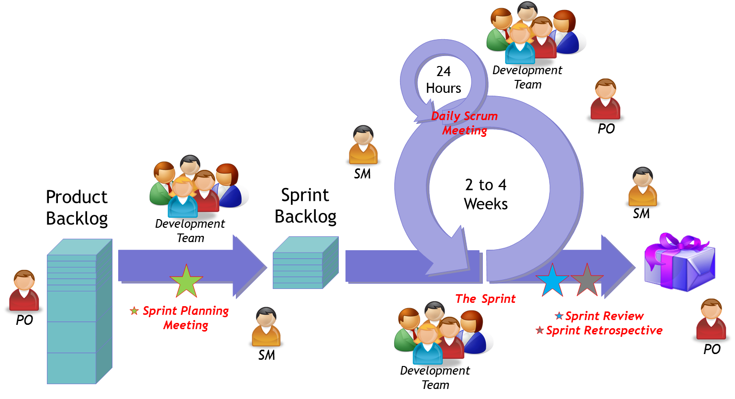
Scrum
Guidance reference: Appendix H
Notes:
Syllabus area
Learning Outcome 1
Assessment Criteria 1.1
At this point it may be a good idea to talk through the whole diagram to explain how the five events, the three roles and the three artefacts combine together.

Slide 117
The Scrum team
Self-organising
Cross-functional
Flexible, creative, productive
The Roles:
Product Owner
The Development Team
The Scrum Master
Guidance reference: Appendix H
Notes:
Syllabus area
Learning Outcome 1
Assessment Criteria 1.1

Slide 118
Scrum events
Events are prescribed to create regularity
Every event has a maximum duration
The Sprint is at the heart of this concept
Forces transparency
Opportunities to inspect and adapt
Guidance reference: Appendix H
Notes:
Syllabus area
Learning Outcome 1
Assessment Criteria 1.1

Slide 119
The 5 Scrum events
The Sprint
Sprint Planning Meeting
Daily Scrum
Sprint Review
Sprint Retrospective
Guidance reference: Appendix H
Notes:
Syllabus area
Learning Outcome 1
Assessment Criteria 1.1
The most common “unofficial” event is backlog refinement.

Slide 120
Scrum artefacts
Product Backlog
Sprint Backlog
Increment
Guidance reference: Appendix H
Notes:
Syllabus area
Learning Outcome 1
Assessment Criteria 1.1

Slide 121
KANBAN
Notes:
Syllabus area
Learning Outcome 1
Assessment Criteria 1.1 and 1.3
This section looks at the Kanban method.

Slide 122
Kanban and the Kanban Method
Kanban systems are visual management systems that limit the number of work items in circulation
Kanban should be seen as a way to increase agility through:
Improved day-to-day decision making
The deferral of commitment
Reduced lead times
In PRINCE2 Agile it is applicable in a project context to time boxes
Guidance references: Section 20.4.1
Notes:
Syllabus area
Learning Outcome 1
Assessment Criteria 1.1 and 1.3
It is essential that anyone training PRINCE2 Agile understands the Kanban content referred to in the PRINCE2 Agile manual. Although the term is widely recognised, it is not that commonly practised. However, at the time of the launch of this training course its popularity is increasing rapidly and it is being seen by many as an alternative to scrum.
One of the most common mistakes in agile is for people to mistake using Kanban with using a Kanban board. This is a bit like confusing and an apple with an orchard! It may be advisable for a trainer to train within their comfort zone as the wider concept of Kanban and the Kanban method (created by David J Anderson who helped with PRINCE2 Agile) is quite a large subject area
It is also essential to let delegates know that Kanban is being used inside the project, for example in timeboxes which is not its normal habitat (which is usually in a context of an operational service such as a service desk).

Slide 123
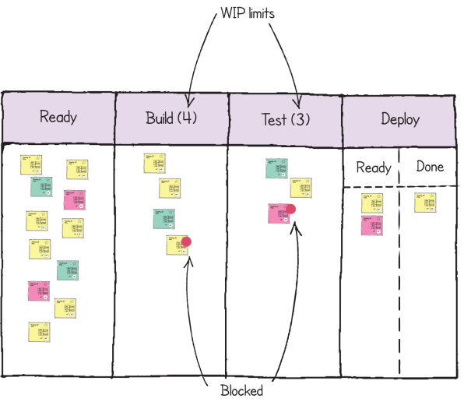
The 6 general practices of the Kanban Method
1. Visualisation
To show how work is progressing
To show what is still to do
To show what problems exist
Guidance reference: Section 20.4.1.2, Figure 20.2
Notes:
Syllabus area
Learning Outcome 1
Assessment Criteria 1.1 and 1.3
A trainer should know and be able to explain the six general practices. Although this is not a simple thing to pick up it is not rocket science either.

Slide 124
The 6 general practices of the Kanban Method
2. Limiting ‘Work in Progress’ (WIP)
A fundamental concept in Kanban that may appear counterintuitive
WIP limits underpin the ‘pull’ system
Kanban avoids scheduling work at specific times
It pulls work when capacity exists
Reduces the impact of task switching and multitasking
Guidance reference: Section 20.4.1.2, Figure 20.2
Notes:
Syllabus area
Learning Outcome 1
Assessment Criteria 1.1 and 1.3
This is the big one from a learning point of view, as the idea of limiting WIP does not necessarily make sense intuitively. It will make sense when you see how it works. A simple example is variable speed limits on a motorway, although this analogy is only partially helpful as it does not take into account task switching. WIP limits create and underpin the whole concept of Kanban.

Slide 125
The 6 general practices of the Kanban Method
3. Manage the flow
the team constantly looks at ways to maximise flow
Waste is removed as quickly as possible
4. Making policies explicit
Boundaries need to be clearly defined about how a team works
Policies should evolve over time
Guidance reference: Section 20.4.1.2, Figure 20.2
Notes:
Syllabus area
Learning Outcome 1
Assessment Criteria 1.1 and 1.3
4 is similar to working agreements

Slide 126
The 6 general practices of the Kanban Method
5. Implement feedback loops
Ultimately, value being delivered is judged by the final consumer
Quantitatively assessing this will directly affect what will subsequently be delivered
6. Improve collaboratively, evolve experimentally
The method builds on collaboration through experimental improvement
Process improvement is everyone’s business every day
Guidance reference: Section 20.4.1.2, Figure 20.2
Notes:
Syllabus area
Learning Outcome 1
Assessment Criteria 1.1 and 1.3
5. A lot depends on whether or not this feedback is with a real customer.
6. The Kanban method uses the term experiment whereas other agile methods may use the word spike or prototype but these experiments have an air of science about them as hypotheses are proven or disproven.

Slide 127
Kanban – further guidance
Scrumban is the application of Kanban where the underlying process is based on Scrum
Policies may exist for similar work items as flow may be more predictable
A team may look to improve how the system works by carrying out experiments in a controlled and objective way
Guidance reference: Section 20.4.1.2, Figure 20.2
Notes:
Syllabus area
Learning Outcome 1
Assessment Criteria 1.1 and 1.3
Be careful when talking about Scrumban as you can either get the best of both worlds or the worst!

Slide 128
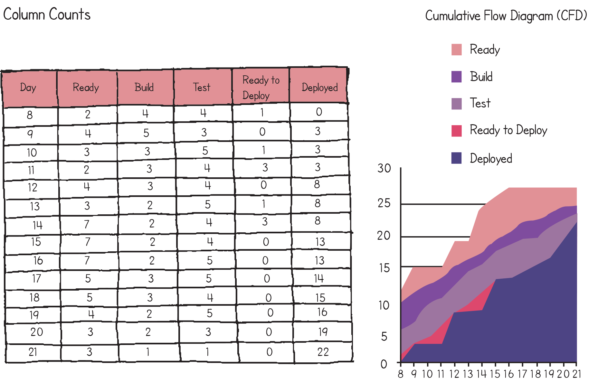
Cumulative Flow Diagrams (CFDs)
Cumulative Flow Diagrams (CFDs) track work items and show the amount of work in each column each day
In simple terms WIP is the vertical difference between the top and bottom lines whereas the horizontal difference shows the lead time
Guidance reference: Section 20.4.1.3, Figure 20.4
Notes:
Syllabus area
Learning Outcome 1
Assessment Criteria 1.1 and 1.3
It is important to understand what a CFD is and this may take some time to understand. On the slide, the CFD diagram represents what is in table; in simple terms the diagram can show how much work is in progress and also what is the lead time. A CFD is about as hard as it gets from the point of view of knowing Kanban for PRINCE2 Agile but it is worth the effort when you get there!

Slide 129
LEAN STARTUP
Notes:
Syllabus area
Learning Outcome 1
Assessment Criteria 1.1 and 1.3
This section looks at the Lean Startup method.

Slide 130
The Lean Start-up
Core concepts are:
Build, Measure, Learn
Create a Minimum Viable Product (MVP)
Fail fast learn fast
Validated learning
Lean Start-up focusses on uncertainty, learning and handling change
It refers to ‘shortening or accelerating the feedback loop’
Learning needs to be measurable
Guidance reference: Section 20.4.2
Notes:
Syllabus area
Learning Outcome 1
Assessment Criteria 1.1 and 1.3
Lean Start-up is a popular agile book by Eric Ries.
Some of the stories inside the book and concepts are very interesting and at times unbelievable, but in some respects this represents a sophisticated strain of agile, which, to many people is a great way to work. Although it is a book about start-up companies, this is analogous to a project and the parallels are easy to make.
It may be worth training this by recounting one of the many stories that Eric Ries tells. In really simple terms, one involves a company that released a product after six months that nobody wanted. They could have known about this after one month, by releasing a cut down version early. The killer concept that Lean Startup brings to the agile table is that what the company lost by delaying the release of the product was not five months of revenue but five months of learning. This is why the Lean Startup focuses on determining a minimum viable products or MVP. This same concept can be applied in project terms, but it must be understood that the Lean Startup focuses on learning, not on commercial viability as mentioned earlier.
Note to trainers:
It would be advisable to research this book on the web, focusing particularly on the official website and watching any videos by Eric Ries. If you can skim-read the book, then even better but having a basic understanding of the Lean Startup is highly recommended to train PRINCE2 Agile.

Slide 131
The Lean Start-up
If you are going to fail, fail fast – the key point being ‘the later you fail the later you learn’
A ‘pivot’ is a significant change in direction as a result of something major surfacing that wasn’t expected
Minimum Viable Product (MVP) - ‘version of the final product which allows the maximum amount of validated learning with the least effort’
An MVP may not go into operational use and may be an experiment
Releasing frequently can help with metrics
Guidance reference: Section 20.4.2
Notes:
Syllabus area
Learning Outcome 1
Assessment Criteria 1.1 and 1.3
Bullet one is something to be focused on and emphasised. When training this section on Lean Startup, you will need to know what a pivot is. This will not take long but it is an important concept that may occur on a project.
Interestingly enough, early on in the book, it says that agile/adaptable has to be a managed process. This resonates quite happily with PRINCE2 and goes against a lot of the ducking and diving that some people assume agile needs.

Slide 132
TRANSITIONING TO AGILE
Notes:
Syllabus area
Learning Outcome 5
Assessment Criteria 5.1
This section looks at transitioning to agile ways of working.

Slide 133
Transitioning to Agile
Agile is an enabler that helps solve problems and leverage opportunities
Create a baseline before starting the journey
There are distinctly different types of success on a project:
The success of the Business Case
The success of the project
The success of agile
Investing in agile needs to be measured in order to gauge success
Guidance reference: Appendix F
Notes:
Syllabus area
Learning Outcome 5
Assessment Criteria 5.1

Slide 134
Advice for a Project Manager using agile
Tips created by the team that created PRINCE2 Agile
Covers the following areas:
Collaboration and self-organisation
Transparency, Communication and Exploration
Environment
Plan, Monitor and Control
Guidance reference: Appendix G
Notes:
Syllabus area
Learning Outcome 5
Assessment Criteria 5.1

Slide 135
Health Check (Appendix C)
A checklist to assess how well a project is going from an agile perspective
The PRINCE2 health check should be used as well
The totality of answers will give a general indication
Covers the following areas:
Behaviours
Environment
Process
Techniques
Guidance reference: Appendix C
Notes:
Syllabus area
Learning Outcome 5
Assessment Criteria 5.1
The final slides appear later on in the manual as appendices and contain a lots of very useful information so they should not be skipped through lightly.

Slide 136
In summary
PRINCE2 can be very effective in an agile context
Tailoring is about creating an appropriate blend of the two
PRINCE2 is already enabled to work with agile
Agile covers a wide range of behaviours, concepts, frameworks and techniques
Using agile is always a question of ‘how much can be used according to the situation?’
Notes:
Syllabus area
Learning Outcome 5
Assessment Criteria 5.1
PRINCE2 Agile, a marriage

Slide 137
Course complete

Slide 138
Contact AXELOS
Web: AXELOS.com
Twitter: @AXELOS_GBP
G+: AXELOS
LinkedIn: AXELOS Global Best Practice
YouTube: AXELOS
Notes:
One agile concept is that of continuous improvement and seeking feedback.
Encourage any delegates to engage with PRINCE2 Agile and feedback to AXELOS if they have any comments both positive or negative.

